Slide 1
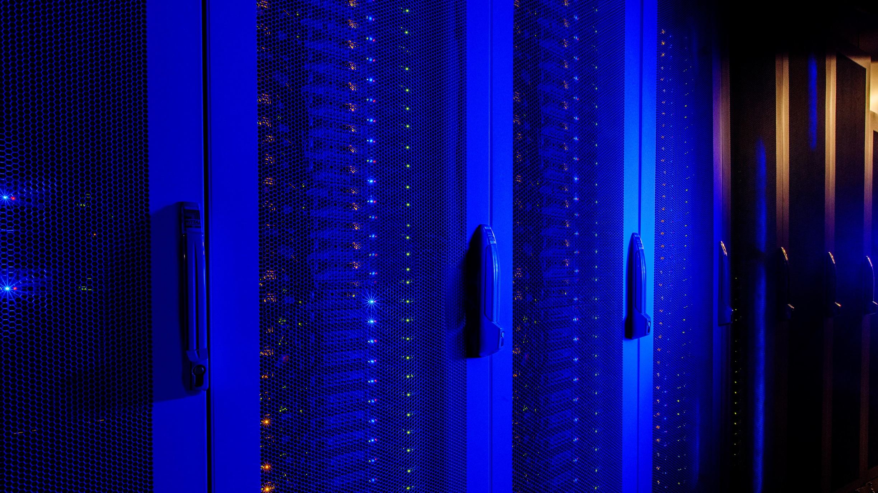

A Case for Multi-Programming
Quantum Computers
Poulami Das*
Swamit S. Tannu*
Prashant J. Nair#
Moinuddin Qureshi*
*Georgia Institute of Technology
#The University of British Columbia

Slide 2



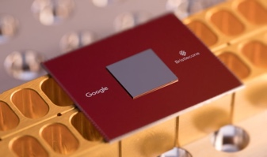
Why Quantum Computing?
Quantum computers can solve hard problems that conventional computers cannot in a reasonable amount of time
Quantum computers with 50+ qubits already available!
Provider
# Qubits
5, 16, 20, 53
53, 72
19
49
Notes:
Quantum computers can solve several problems that are otherwise not possible to solve in a reasonable amount of time- problems in chemistry, optimization, prime factorization, machine learning
Quantum computers are available today from multiple vendors and there are several other industrial and academic efforts currently in progress

Slide 3
Noisy Intermediate Scale Quantum (NISQ) Computing
Noise leads to high error rates on existing and near-term quantum computers
Near term Quantum Computers too small for Quantum Error Correction
Referred to as NISQ computers- John Preskill
0.4
Compiler
NISQ Machine
0.3
Program
Output Log
Probability
0.2
0.1
Repeat N trials
N is large, 8192 for IBM-Q16
00
01
10
11
Possible Outcomes
Reliability measured using Probability of Successful Trial (PST)
NISQ computers will be operated in the presence of noise and reliability is measured using the PST from multiple trials
Notes:
Existing and near-term quantum computers suffer from large amounts of noise that leads to very high error rates
Click: Although there exists quantum error correction techniques, they are not practically feasible on these machines because there are only a few qubits
Click: These machines are referred to as NISQ computers and will be available in the next few years. Since these machines operate in the presence of noise, program execution is not reliable
Click: Now in order to execute programs in the presence of noise, NISQ programs use an iterative model, in which a program is compiled and executed on the NISQ machine several times and the output is logged. Each iteration is called a trial and programs typically use a large number of trials,
Click: For example, programs on IBM-Q16 are generally executed for 8K trials.
Click: The output log is used to generate a probability distribution
Click: with the hope that the peak of the distribution corresponds to the correct answer
(Delayed) : The reliability is often measured using the probability of successful trial or PST which represents the ratio of the number of trials with correct outcome to the total number of trials. This metric is used in other prior works as well as few concurrent works.

Slide 4
Underutilization in NISQ Computers
Q0
Error rates limit the number of reliable operations
Quantum
Gates
Q1
Width
...
QN
Depth
Given CNOT budget
High
Width
Low
Low
High
Depth
Programs may not use all the qubits leaving unused resources
Notes:
Due to extremely high error rates, the number of operations that can be executed before error happens is very low
Click: For example, this graph shows the probability that a computation is error free after a given number of CNOT operations. We choose CNOT operations because they dominate the instruction streams of most quantum programs. We study three different error rates and observe that only few tens of operations can be performed without large errors in computations. From the graph we can clearly see that only few tens of operations can be performed without large errors in computations. So how does this impact the type of programs we can run?
Click: A program can be represented in a 2D space given by number of qubits (or width) and maximum number of gate operations per qubit (depth).
Click: Now usually high depths circuits cannot be executed reliably because of decoherence effects as qubits do not retain their state indefinitely. Now that we have a given CNOT budget,
Click: we can either spend it on depth
Click: or on width
Click: or typically in the intermediate space between the two which effectively means only programs with low depth and width are the ones that can execute reliably
Click: This means that typical programs may not use all the available qubits on a NISQ computer leaving unused/idle qubits.

Slide 5
Quantity vs. Quality Gap
5 to 53 qubits
Error: 4.5 % to 1.8 %
2016
3 years
2019
With current scaling of error rates, it is difficult to use all the qubits
Notes:
The underutilization problem is worsened by the gap that exists between the different rates of scaling number of qubits and error rates. For example, here we see how the number of qubits and average gate error rates have scaled for the IBM machines.
Click: We observe a time frame of 3 years
Click: And we see that the number of qubits have gone up from 5 to 53
Click: whereas the error rates have only improved from 4.5 % to 1.8 %
Click: Which means that with the current scaling trends of error rates, it is difficult to use all the qubits which worsens the utilization problem as systems grow in size.

Slide 6
Demand for Limited NISQ Resources
High Demand
Increasing Gap
Pending Requests for access to IBM Q16 on different days
Expensive and Limited
Limited NISQ resources must scale to a large number of users
Notes:
The quantum community is growing very rapidly and data reported by IBM showed how a million experiments were being run on their public machines in a month
Click: Quantum computers are expensive to build, operate and maintain and are therefore only limited in number. We do not even have 20 of these machines across the entire world!
Click: This creates an increasing gap between demand for resources and the availability of resources
Click: And this is clearly visible in the waiting traffic for one of the IBM machines
Click: This clearly shows that these limited quantum resources must scale to a large number of users.

Slide 7
Our Proposal: Multi-Program Quantum Computers
Multi-programming can improve throughput and utilization
time = T1
P1
time = T1
P1
time = T2
P2
P2
Current Approach
Proposed Approach
Notes:
The utilization and throughput of a NISQ computer can be significantly increased by concurrently running two programs
To overcome some of the challenges I just described, we propose multi-programming quantum computers as a solution.
Click: Lets take an example toy quantum computer. In the existing approaches, if a 4-qubit program P1 runs at time t=T1, another 4-qubit program P2 will run at time t=T2
Click: However, we observe that in both case, 50% of the qubits remain idle
Click: Whereas in our proposed approach, if the quantum computer could be multi-programmed, at time t=T1, while program P1 is being executed, P2 could be simultaneously executed too
Click: This way clearly the machine throughput and the utilization has increased

Slide 8
Challenges in Multi-Programming NISQ Computers
2
3
2
2
3
2
10
Correctness and Reliability Issue!
Bad
Link
3
3
3
P1
P2
Fairness in resource allocation
Reduce interference
Our goal is to enable multi-programming to improve the throughput and utilization of quantum computers while minimizing the impact on reliability
Notes:
While multi-programming has benefits, there are several challenges. Lets take a look at the same example, but have a closer look
Click: We are now looking at the error rates in this system. What we can see here is that the second program gets this particularly bad link and its reliability will therefore be lower that what it would have been had it not been mapped in the shared environment. Here mapping refers to the process where program qubits are allocated to physical qubits and qubit movement paths are determined by the compiler for program execution; and existing compilers are optimized to do so.
Click: This means that unlike conventional machines, multi-programming a quantum computer has correctness and reliability issues.
Click: This brings us to the very first challenge of multi-programming i.e. how to ensure fairness in resource allocation?
Click: The second challenge is related to interference. NISQ computers are very sensitive systems and running more programs increases the activity on the machine and causes interference. So we need solutions to mitigate this.
Click: Our goal is to enable multi-programming to improve the utilization and throughput of quantum computers with minimal impact on program reliability

Slide 9
Outline
Introduction
Background and Motivation
Policies for Multi-Programming
Evaluation Methodology
Adaptive Multi-Programming Design
Results and Conclusion

Slide 10
Overview Of Our Proposals
Calibration Data
Programs
Partition Algorithm
Do
partitions
exist?
No
Execute on NISQ machine
Compile Independent
Compute PST
Yes
Execute on NISQ machine
Compile Together
Split Outputs
Partitions for Programs
Notes:
Before I discuss the details of our work, I will give a brief overview. We design a scalable partitioning algorithm that takes in the programs and the machine calibration data. Calibration data provides information about error rates and other vital machine parameters.
Click: The algorithm then checks if there exists two partitions where the programs can be executed together.
Click: If there exists no such partitions where these programs can be mapped together, they are compiled independently.
Click: However, if there exists reliable partitions where the programs can be mapped together, the partitions are used by the compiler to compile the programs together.
Click: They can then executed on a NISQ Computer.
Click: If programs were run together, the output distributions obtained from the machine are split.
Click: And the results are used to compute the PST and obtain the final answer.
Click: Our key contributions are designing a fair and reliable partitioning algorithm and
Click: Instruction scheduling policies for parallel programs.

Slide 11
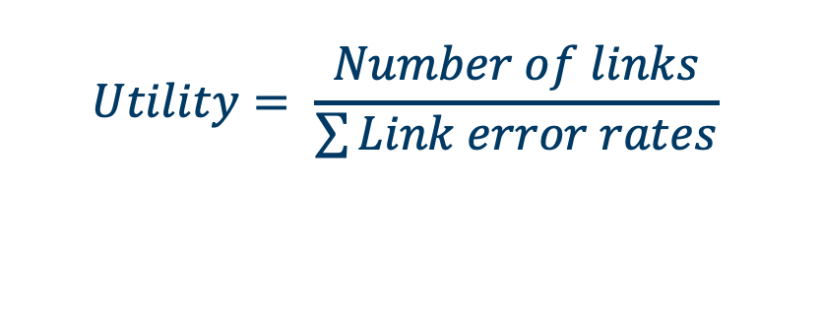
Fair And Reliable Partitioning (FRP) Algorithm
High
Medium
Low
2
3
2
2
3
2
10
3
3
3
$$Utility= \frac{Number of links}{\sum{Link error rates}}$$
4 qubit program
3 qubit program
Algorithm ensures each program is allocated reliable qubits
Notes:
Our first contribution is the FRP algorithm that ensures fairness and reliability in sharing resources between programs. Let’s take the same toy NISQ computer with the error rates as shown, and lets see how this NISQ computer can be partitioned.
Click: In the first step, the algorithm assigns utility to every physical qubit where utility is defined as the ratio of the number of links to the sum of error rates.
Click: In the next step, the qubits are grouped into three separate groups depending on the utility (high, medium, low). For example, here the green qubits have highest utility while the orange ones have the lowest.
Click: Then, by choosing a high utility qubit with good neighbors as the root, the algorithms grows a sub-graph that comprises of the required number of qubits to map a program. For instance, we can see how the 4 qubit program is mapped here.
Click: The algorithm now checks if it can find a sub-graph of good reliability from the unmapped qubits. As we can see here, the algorithms can locate a region where a different 3-qubit program can be mapped.
Click: Using this approach, the algorithm ensures each program can get a fair share of qubits. [Our algorithm also uses a mechanism to eliminate adding qubits with high measurement errors in to a sub-graph. ]
** Discuss Utility metric

Slide 12


Fair And Reliable Partitioning (FRP) Algorithm
Is a program’s resource allocation in shared environment fair?
Calibration Data
P1 mapping
Profile
Estimate $∆($region error rate)
$∆$Error rate P1, P2 < $∈$ ?
P1
Qubit Map
P2 mapping
Decision
P2
Profile
P1 + P2 shared mapping
Algorithm ensures fairness while sharing resources between programs
Notes:
Now how to ensure that a program’s resource allocation in the shared environment is fair and as good as it would have been had they not been sharing resources.
Click: To ensure fairness, while trying to map programs, the algorithm generates a program profile where it gathers statistics about the usage of every logical qubit and every other logical qubit it interacts with.
Click: The algorithm uses this information and calibration data to perform qubit mapping.
Click: But besides generating the mapping for both programs together, the algorithm also generates mappings for the programs to executed individually.
Click: The algorithms now computes the mean error rate for the regions allocated to each program in the shared vs isolated mode.
Click: The algorithm checks if the difference in the region error rate is less than an acceptable threshold and based on it makes a decision on whether to enable multi-programming or not.

Slide 13
Instruction Scheduling
How to schedule parallel programs?
P1
M
Interference
Programmers’ View
P2
M
Decoherence
P1
M
Existing approach
P2
M
IBM’s Compiler schedules measurements after all gates
Two irregular sized programs can suffer from interference and decoherence
Notes:
The next part of our work focuses on how should we schedule Parallel Programs?
Click: Ideally how does a programmer want to schedule parallel programs? Ideally the programmers expects that the two programs will execute just like two independent threads, completely decoupled. This means that whenever a program ends, the qubits will be measured after that.
Click: The issue in this approach is that now the measurement operations of the shorter program may interfere with the on-going program’s gate operations.
Click: So to prevent this, existing approaches avoid this scenario and allows the same two programs to complete but performs all the measurements in the end. For example, IBM compiler currently uses this type of scheduling approach and performs all measurement operations only at the end.
Click: The only problem is now the qubits of the shorter program may decohere by the time they are measured.
Click: Therefore, we observe that we are facing interference and decoherence while scheduling parallel programs. So how can we reduce this?

Slide 14
Delayed Instruction Scheduling (DIS) Policy
Delay
Measurements at the end
  Reduces interference
Delay shorter program
  Reduces decoherence
Barriers
P1
M
P2
M
Barriers
Our proposed DIS policy reduces interference and decoherence and is scalable
Notes:
We introduce the Delayed Instruction Scheduling policy and lets see how it works by taking a look at the same programs.
Click: In this case, all the measurement operations take place in the end. This reduces the interference with the co-running application from measurement operations.
Click: Depending on the length of the longer program, appropriate delay is inserted to slow down the shorter program while scheduling instructions. Such a policy ensures that the programs complete at the same time (prevents decoherence)
Click: To ensure correct ordering, appropriate barriers are inserted
Click: While we just show here the policy for only two programs, the problem persists even when more programs share execution time and this policy can address those cases because it is scalable
**** In case people ask how much is the benefit from scheduling-> 3% improvement in the PST of the longer thread. We must account for the the fact that measurements on IBM-Q16 are all serialized and we are likely to see greater improvements if measurement crosstalk can be reduced and measurements can be done in parallel. There are few device level solutions for that and Google has already explored the possibility of parallel measurements in their Sycamore processor. (More pointers in the backup slides)

Slide 15
Outline
Introduction
Background and Motivation
Policies for Multi-Programming
Evaluation Methodology
Adaptive Multi-Programming Design
Results and Conclusion
Notes:
1. Before we discuss our preliminary results I will like to discuss our evaluation framework.

Slide 16
Evaluation Methodology
IBM Q16
  14 qubit public machine
Benchmark | Description | #Insts | #CNOT
bv_n3 | Bernstein Vazirani | 8 | 2
bv_n4 | Bernstein Vazirani | 11 | 3
Toffoli_n3 | Toffoli gate | 15 | 6
Fredkin_n3 | Fredkin gate | 16 | 8
Peres_n3 | Peres gate | 16 | 7
Benchmarks
  From prior works
Baseline: Isolated execution using best qubit mapping
Notes:
All our experiments are performed on IBM Q16, a publicly available 14-qubit quantum computer from IBM
Our benchmarks are derived from prior works
Since Q16 is a small machine with only a handful of good links and qubits (as we see here), we restrict ourselves to workload mixes of 2 programs, and run only small benchmarks.
For the baseline, we execute each workload independently using the best qubit mapping

Slide 17
Results of Multi-Programming
Throughput improved by 2x
10% loss in PST on an average
Multi-programming can improve throughput with slight impact on PST
Notes:
Here are the preliminary results.
Click: This shows the PST of each workload relative to the baseline. The workloads are shown on the X-axis and the relative PST is shown on the Y-axis.
Click: We observe that the throughput of the NISQ machine can be improved by 2x with only about a 10% drop in PST.
Click: Clearly multi-programming can improve the throughput at the cost of slight impact on PST

Slide 18
Limiting the Reliability Impact of Multi-Prog
Throughput improved by 2x
Significant impact ~22%
10% loss in PST on an average
Multi-programming must adapt to minimize significant impact on reliability
Notes:
Why do we need adaptive multi-programming? Lets look at the same results but a closer one
Click: We observe that although the mean loss in PST is about 10%, there may be instances when the impact is significant as we observe in this case (22%)
Click: Since quantum computers are accessible through cloud services, this is a compromise on the quality of service
Click: So we need adaptive solutions where multi-programming can be disabled at run time if needed

Slide 19
Outline
Introduction
Background and Motivation
Policies for Multi-Programming
Evaluation Methodology
Adaptive Multi-Programming Design
Results and Conclusion

Slide 20
Runtime Reliability Monitoring
Can we detect impact on reliability at runtime?
0.4
0.3
Probability
Independent Trials
0.2
0.1
Statistical Tests
Impact Detected
Program
00
01
10
11
Possible Outcomes
0.4
Shared Trials
Probability
0.3
0.2
0.1
00
01
10
11
Possible Outcomes
Using statistical tests degradation in program reliability can be captured
Notes:
In order to disable multi-programming at runtime, the first thing we need is a mechanism to detect an impact on reliability at the runtime. Once detected, fixing it is trivial
Click: So to detect an impact we propose that a program be executed independently for a few trials, besides the shared execution. Since the independent trials are done in an isolated environment, it gives a frame of reference to compare the shared trials results against
Click: From the two executions, we get two possible probability distributions and using statistical tests (that I will describe soon), an impact on reliability can be detected.
Click: And therefore, using this mechanism the impact on program reliability can be captured

Slide 21

Description of the statistical tests
Entropy: measures randomness
Hellinger Distance: measures correlation between distributions
0.7
0.5
0
1
0
1
1
0
Prob.
Prob.
Prob.
Prob.
Prob.
0.1
0.1
0.1
0.2
0.2
0.1
a
b
c
d
a
b
c
d
a
b
a
b
a
b
Outcomes
Outcomes
Outcomes
Outcomes
Outcomes
Dist 1
Dist 2
D1
D2
D3
Low Entropy
High Entropy
HD=0
HD=1
Noise
Compare $Entropy(Shared Trials)$ and $Entropy(Independent Trials$)
How similar or dissimilar are the shared and independent trials?
Notes:
We use two statistical tests; Entropy: which measures randomness in a system. Entropy is higher in the presence of noise.
Click: For example here we look at two distributions
Click: The one with higher peak has lower entropy
Click: Whereas the one with more noise has higher entropy
Click: So by comparing the entropy of the shared trials against the independent trials, we can estimate how noisier was the execution in the shared mode.
Click: The second metric we use is Hellinger Distance: it measures the correlation between two distributions.
Click: Lets say we have this distribution D1 where there are two possible outcomes, a and b that occurs with probabilities 0 and 1 respectively.
Click: If we have another distribution (D2) that is exactly identical to D1, their HD is 0.
Click: Whereas, if we have a distribution as D3 that is completely dissimilar, HD = 1. For anything in between 0<HD<1.
Click: So by computing the H-Dist, we can determine how similar or dissimilar are the shared and independent executions.

Slide 22
AMP Design Implementation
I Independent Trials
Independent Queue
Disable Multi-Programming
Queue Manager
Schedule
Process
Output
Incoming Job Queue
Shared Queue
Analyses Reliability
S Shared Trials
S >> I
Multi-programming is adaptive to mitigate severe impact on reliability
Notes:
How is the adaptive multi-programming design implementation?
Click: As I have mentioned before that quantum computers are available through cloud services, so typically the service provider received job requests which are maintained in the Incoming Job Queue
Click: These jobs are now analyzed by the Queue Manager. The Queue manager maintains two queues (independent queue and the shared queue) and hosts the compiler
Click: If the queue manager finds a job for which a user has requested specific allocation or requires access to entire machine and therefore cannot share resources, it puts the job in the Independent Queue.
Click: However, if the Queue Manager can locate two jobs on the Incoming job queue which can share resources, it compiles them together using our proposed algorithms and puts the job object on the Shared Queue.
Click: At the same time, these programs are compiled independently and put into the Independent Queue.
Click: These corresponds to the shared trials and independent trials I discussed earlier. For multi-programmed jobs, S>>I to ensure throughput benefits are still retained. This is a trade-off between reliability and throughput
Click: These jobs can now be scheduled and executed on the NISQ machine
Click: Now the statistical tests are used to determine degradation in program reliability.
Click: If no impact is detected, the output is returned
Click: Whereas, if an impact is detected multi-programming is disabled only for that application

Slide 23
Outline
Introduction
Background and Motivation
Policies for Multi-Programming
Evaluation Methodology
Adaptive Multi-Programming Design
Results and Conclusion
Notes:
Moving on to final results and conclusion

Slide 24
Final Results
Maximum loss in PST = 12%
Shared trials have 1.4x entropy
Mean loss in PST 7.7%
Mode: S=6K, I=2K
Throughput improved by 1.6x
Notes:
I will be discussing the results where we run 6K shared trials and 2K independent trials
Click: We observe a mean loss in PST of 7.7%
Click: The maximum loss observed is about 12%
Click: But in this case the entropy of the shared trials is 1.4x the entropy of the independent trials
Click: The overall throughput is improved by 1.6x
Click: There are results for other modes in the paper that you may look at if you are interested

Slide 25
Conclusion
We proposed multi-programming to improve NISQ machine throughput and utilization
We designed scalable policies for fair resource allocation, minimizing interference, and adaptive multi-programming
Our solutions can be implemented by both user and service provider
Machine throughput can be improved up to 2x with minimal loss in PST
Notes:
To conclude: we proposed multi-programming quantum computers to improve the throughput and utilization
Click: We designed policies that can overcome the challenges in multi-programming quantum computers and minimize the impact on program reliability
Click: Our solutions are scalable and can be implemented by both the user and service provider
Click: For the workloads we tested and on IBM Q16 the machine throughput can be improved by 2x with nominal loss in PST

Slide 26
Thank You!

