Slide 1

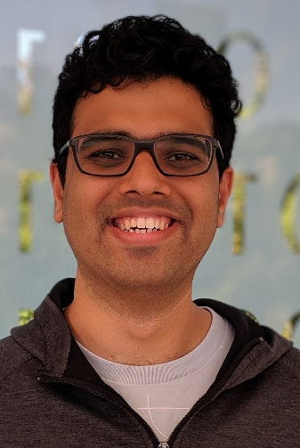

Ensemble of Diverse Mappings: Improving Reliability of Quantum Computers by Orchestrating Dissimilar Mistakes
Swamit Tannu
Moinuddin Qureshi
Notes:
Good afternoon I am Swamit From Geogia Tech.
I will Talk about how we can improve the reliability of quantum computers by orchestrating dissimilar mistakes, I did this work with my advisor Moinuddin Qureshi.
So let me tell you about correlated errors using my favorite game show who wants to be Millionaire

Slide 2


40%
20%
20%
20%
80%
20%
20%
20%
20%
20%
A
B
C
D
A
B
C
D
Don’t Know
Correct Answer
Know
Correct answer
Where was first MICRO located ?
A. Bedford, MA
A. Bedford, MA
B. Phoenix, AZ
C. Urbana-Champaign, IL
D. Santa Cruz, CA
Notes:
There is a question with four options
if you don’t know the answer, you can ask the audience.
Its not necessary that Majority of the Audience knows the answer,
Even if 20% of the audience knows the answer you might still be able to guess the right answer
See what I did here I assumed that audience would pick answers uniformly – all votes are equally divided across four candidates, Well that may not be true

Slide 3
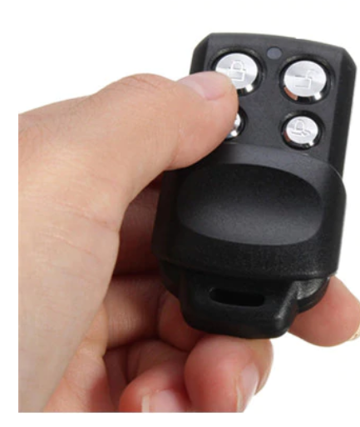



Lazy Audience → Correlated Mistakes
People who don’t know answer tend to select easiest option
Notes:
When People who don’t know the answer they choose the answer which easy to select in this example, they pick answer D – its easy to press. Now this introduces a correlated error. (click)

Slide 4
Impact of Correlated Mistakes on Voting
Correct (20%)
Lazy-Last (20%)
Random
20%
20%
20%
20%
20%
20%
20%
15%
15%
15%
15%
A
B
C
D
A
B
C
D
Wrong answers randomly distributed
20% of audience lazy ➔ Always selects last option
Correlated errors limit the ability to infer the correct answer
Notes:
Lets say if audience is lazy and press the easiest option when they don’t in that case with majority voting correct answer does not shine but the incorrect answer shines, because there is correlation in mistakes.
D is as frequent as A
How can we solve this?

Slide 5
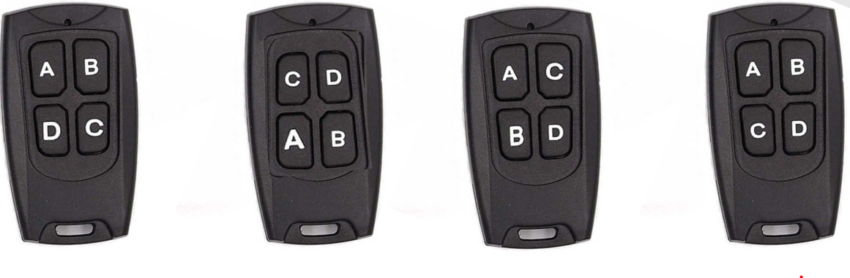
Use Diversity to Break Correlation
Different versions, each with diverse option subjected to error
Notes:
We can solve this by reordering the options such that quarter of audience has the remote with order -
A B C D, quarter of audience
has B C D A, quarter of CDAB, and the quarter DABC.
In this case the correlated error is different for different groups.

Slide 6
Use Diversity to Break Correlated Errors
20%
20%
20%
20%
15%
15%
15%
15%
15%
15%
15%
15%
A
B
C
D
D
A
B
C
20%
Version-1
Version-2
20%
20%
20%
15%
15%
15%
15%
15%
15%
15%
15%
C
D
A
B
B
C
D
A
Version-3
Version-4
Have different versions, each with diverse option subjected to error
Notes:
In version 1 correlated errrors affect D, in second version it affects C and so on
And if create four versions then correlated errors
would be averaged out and we will be able to infer the correct answer.
And aggregated the results and we can defeat the correlated error
Now, Lets talk about quantum computing why all of this is relevant …

Slide 7
Quantum Computers are Here!
Recent demonstrations
Quantum computers can speedup hard problems
Quantum Machine | Number of Qubits*
Google | 72
IBM | 50
Intel | 49
Rigetti | 19
IonQ | 11
100+ Years
Classical Computer
Execution Time
Quantum
Computer
Days
Problem Size
* Under test , fabricated, or announced
QC with 50+ qubits are here, QC with 100+ qubits expected soon
Notes:
Quantum computers can solve problems that are beyond the capabilities of Today computers,
and quantum computers are here. You can access IBM’s qubit machine via a cloud and run programs.
We have quantum computers wih 50+ qubits, and in near future we will have 100+ qubits.
--------------------------- 4 mins

Slide 8
Quantum Computing: Background
QC operates on principles of entanglement and superposition
Error
Single Qubit
gate
State - 1
1
50%
Error
0
Two Qubit
gate (cnot)
State - 0
50%
State of qubit
Entangled state
State of qubit is a superposition of state “0” and state “1”
Gate operations modulate state of the qubit
Notes:
We can solve interesting problems using quantum computers, by using properties of qubits –
properties like superposition. Quantum state for example , exhibit superposition of states 0 and 1 and quantum gates can modulate this superposition
And produce entangled states. Unfortunately quantum gates and bits encounter errros due to noise .. And that is one of the biggest challenge

Slide 9
NISQ Programming Model
Quantum Error Correction is expensive (20x-50x qubits)
Noisy Intermediate Scale Quantum Computer (NISQ) [Preskill’18]
  - Run program without any error correction
Error free outcome
Erroneous outcome
Compile
Executable
Execute
Output
Log
Input Program
Repeat for N Trials
Figure of Merit: Probability of Successful Trial (PST)
Notes:
error correction give us ability to detect and correct errors – but quantum error correction is expensive for quantum computers with 50 qubits
we cant protect qubits by using error correction because its expensive
so until we have tens of thousand of qubits, we will be in this Noisy Intermediate Scale Era, where quantum computers will be noisy.
To infer correct answer on NISQ, we execute a program log the out put and run it again, we run the program 1000s of time and log the out put of each trial, and at the end we analyse this output to infer correct answer
Its very similar to the who wants to be a mIllionair example, we don’t need correct all our trials to be correct or even majority of the trials to be correct as long as correct answer has the highest frequency
we can infer the correct answer.

Slide 10


Limited Connectivity and the Mapping Policy
A
C
CNOT A,C
CNOT B,C
SWAP B,C
CNOT A,B
CNOT A,C
CNOT B,C
CNOT A,B
Q1
Q2
B
Not Possible no coupling link
Between A and B
Q4
Q3
link between A and B, CNOT can be performed
SWAP facilitate data movement
Compiler insert SWAPs → SWAPs are extra instructions which can also fail
Notes:
On quantum computer there is a challenge of limited connectivity. For example.
On Quantum computer, we can perform two qubit operation only if the two qubits are connected.
if we want to perform CNOT between A and B we can not as A is resides on Q1 and B resides on Q3. There is no direct link between Q1 and Q3.
Fortunately, SWAP operations are possible, so we can SWAP B and C and now we can perform CNOT between A and B
It is the job of Compiler to insert SWAP instructions. Note that SWAPs are extra instruction which can also fail, we want to minimize SWAP instructions. Qubit Mapping policies deal with which route to take while moving qubits so that we can minimize number of SWAPs.

Slide 11
Qubit Mapping Policies
SWAP Minimizing Mapping
Variability Aware Mapping
Maslov et. al (2007) [U Waterloo]
Shafaei et. al (2013) [USC]
Paler et. al (2014) [JKU]
Siraichi et. al. (2018) [FUMG]
Li et. al (2019) [UCSB]
Itoko et. al (2019) [IBM] … many more
Tannu et. al (2018) [Georgia Tech]
Murli et. al (2019) [Princeton]
Nishio et. al (2019) [Keio]
Sadlier et. al. (2019) [Oak Ridge]
Venturelli et. al (2019) [NASA]
Ash- Saki et. al (2019) [PSU] … many more
All of the above use same mapping for all trials
Notes:
Qubit allocation is known to b an NP complete problem, and there are heuristics to obtain the best posible sequence of SWAPs
In last years more than half a doze papers that looked at qubit allocation policies to minimize number of
SWAPs (click)
Minimizing SWAPs doesn’t always give you the best reliability (click)
In our previous work we have noted that some qubits have higher rate and some have
So when you want to SWAP avoid using low reliability links and qubits and steer more work to reliable qubits and links. We call this Variation aware qubit mapping policies (click)
There is a lot of follow on work on this also ..
(click)
Mapping policies regardless of there are swap minimizing or variation aware try to find the single best mapping that will be used for all of the trials
For example, (click)

Slide 12
Correlated Errors
Quantum
Program
A
B
Trial 1
C
D
A
B
Trial 2
C
D
Probability
A
B
C
D
:
:
Quantum Computer
Best Mapping
Output
A
B
Trial N
C
D
Same
Mapping for
N Trials
Correlated
Errors
Incorrect output more
probable than correct
Notes:
If you run

Slide 13
Goal
Goal
Design Mapping Policy that Mitigate Correlated Errors to Improve Inference
Notes:
We want to design mapping policy that Mitigate Correlated Errors to Improve Infrenece

Slide 14
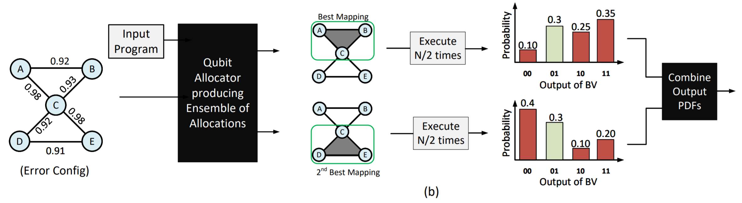
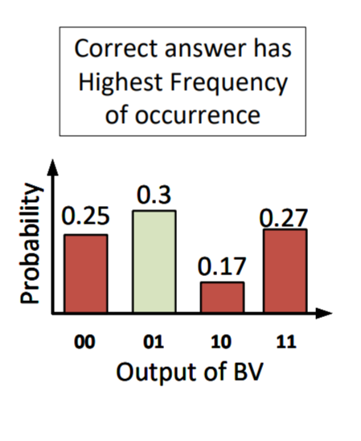
Can We Suppress Incorrect Answers with Diversity?
Notes:
-- 30 % correct answer
-- for the top mapping dominant wrong appears with 35 %, and bootom …
-- Different wrong answer
-- So averaging two accentuates the correct answer

Slide 15
Ensemble of Diverse Mapping: Design
E1
Run for N/4 Trials
M1
E1
E2
M2
E2
Compile
E3
M3
E3
E4
M4
E4
Ensemble of
Qubit Maps
Ensemble of
Quantum
Executables
Ensemble of
Output PDF
Notes:
Explain fig
(PAUSE)
You must have realized now that PST alone doesn’t convey if we can infer the correct answer on NISQ machine.
For the same PST we may or may not able to infer the correct answer depending on what is the magnitude of the wrong answer
So we need a different metric for inference quality and we came up with such a mnetroc

Slide 16

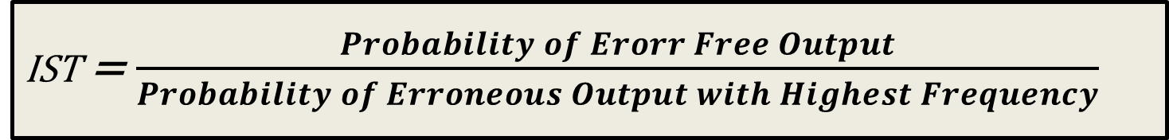


Figure of Merit: Inference Strength (IST)
IST = $\frac{Probability of Erorr Free Output}{Probability of Erroneous Output with Highest Frequency}$
IST = $\frac{0.35}{0.40}$ = 0.87
IST = $\frac{0.3}{0.25}$ = 1.25
PST = 0.35
PST = 0.30
40%
35%
30%
25%
25%
Incorrect
Inference
10%
Correct
Inference
20%
5%
A
B
C
D
A
B
C
D
IST captures quality of inference. IST > 1 ensures correct answer is strongest
Notes:
Example
PST is
We use IST to evaluate inference

Slide 17
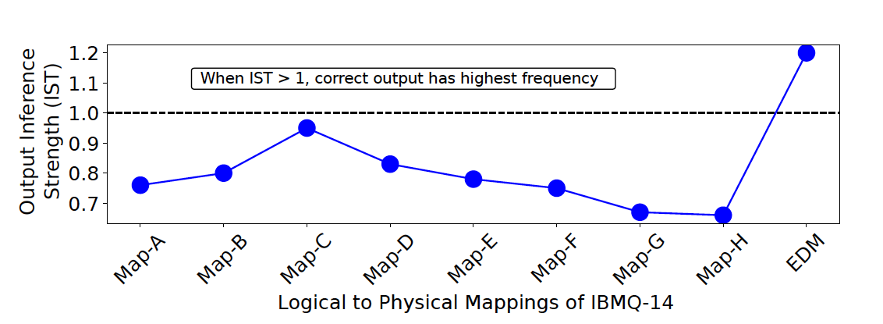
Ensemble of Diverse Mappings: Experiment
EDM creates four copies of the program using mappings A, B, C, and D
With diverse set of mappings we can orchestrate dissimilar mistakes

Slide 18
How Many Members in the Ensemble?
Inference Strength
(IST)
IST > 1 → Correct answer is most likely
Tradeoff: Increasing ensemble size increases diversity in errors but exposes program to weaker qubits adding more errors

Slide 19
EDM: Evaluations on IBM-Q14 system
IST > 1 → Correct answer is most likely
For current quantum kernels, EDM improves the IST by up to 1.5x

Slide 20
Weighted EDM: Design
We use KL Divergence for
M1
E1
E1
W1
M2
E2
W2
Compile
M3
E3
W3
M4
E4
W4
Ensemble of
Qubit Maps
Ensemble of
Quantum
Executables
Ensemble of
Output PDF
Weighted EDM → Use Weighted average of an Ensemble such that unique output has more weight

Slide 21
WEDM Evaluations on IBM-Q14 system
For current quantum kernels, EDM improves the IST by up to 1.73x

Slide 22
Summary
Correlation in qubit errors degrade inference quality on NISQ
Prior work: single best mapping for all trials → correlated errors
EDM: divide trials into groups, use different mapping for each group
EDM Improves the quality of inference up to 2X on IBMQ-14 machine
Okay to make mistakes, but not the same one again and again

Slide 23
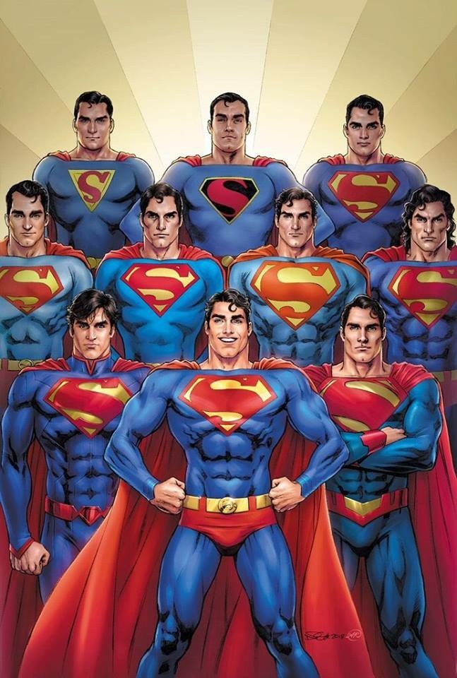
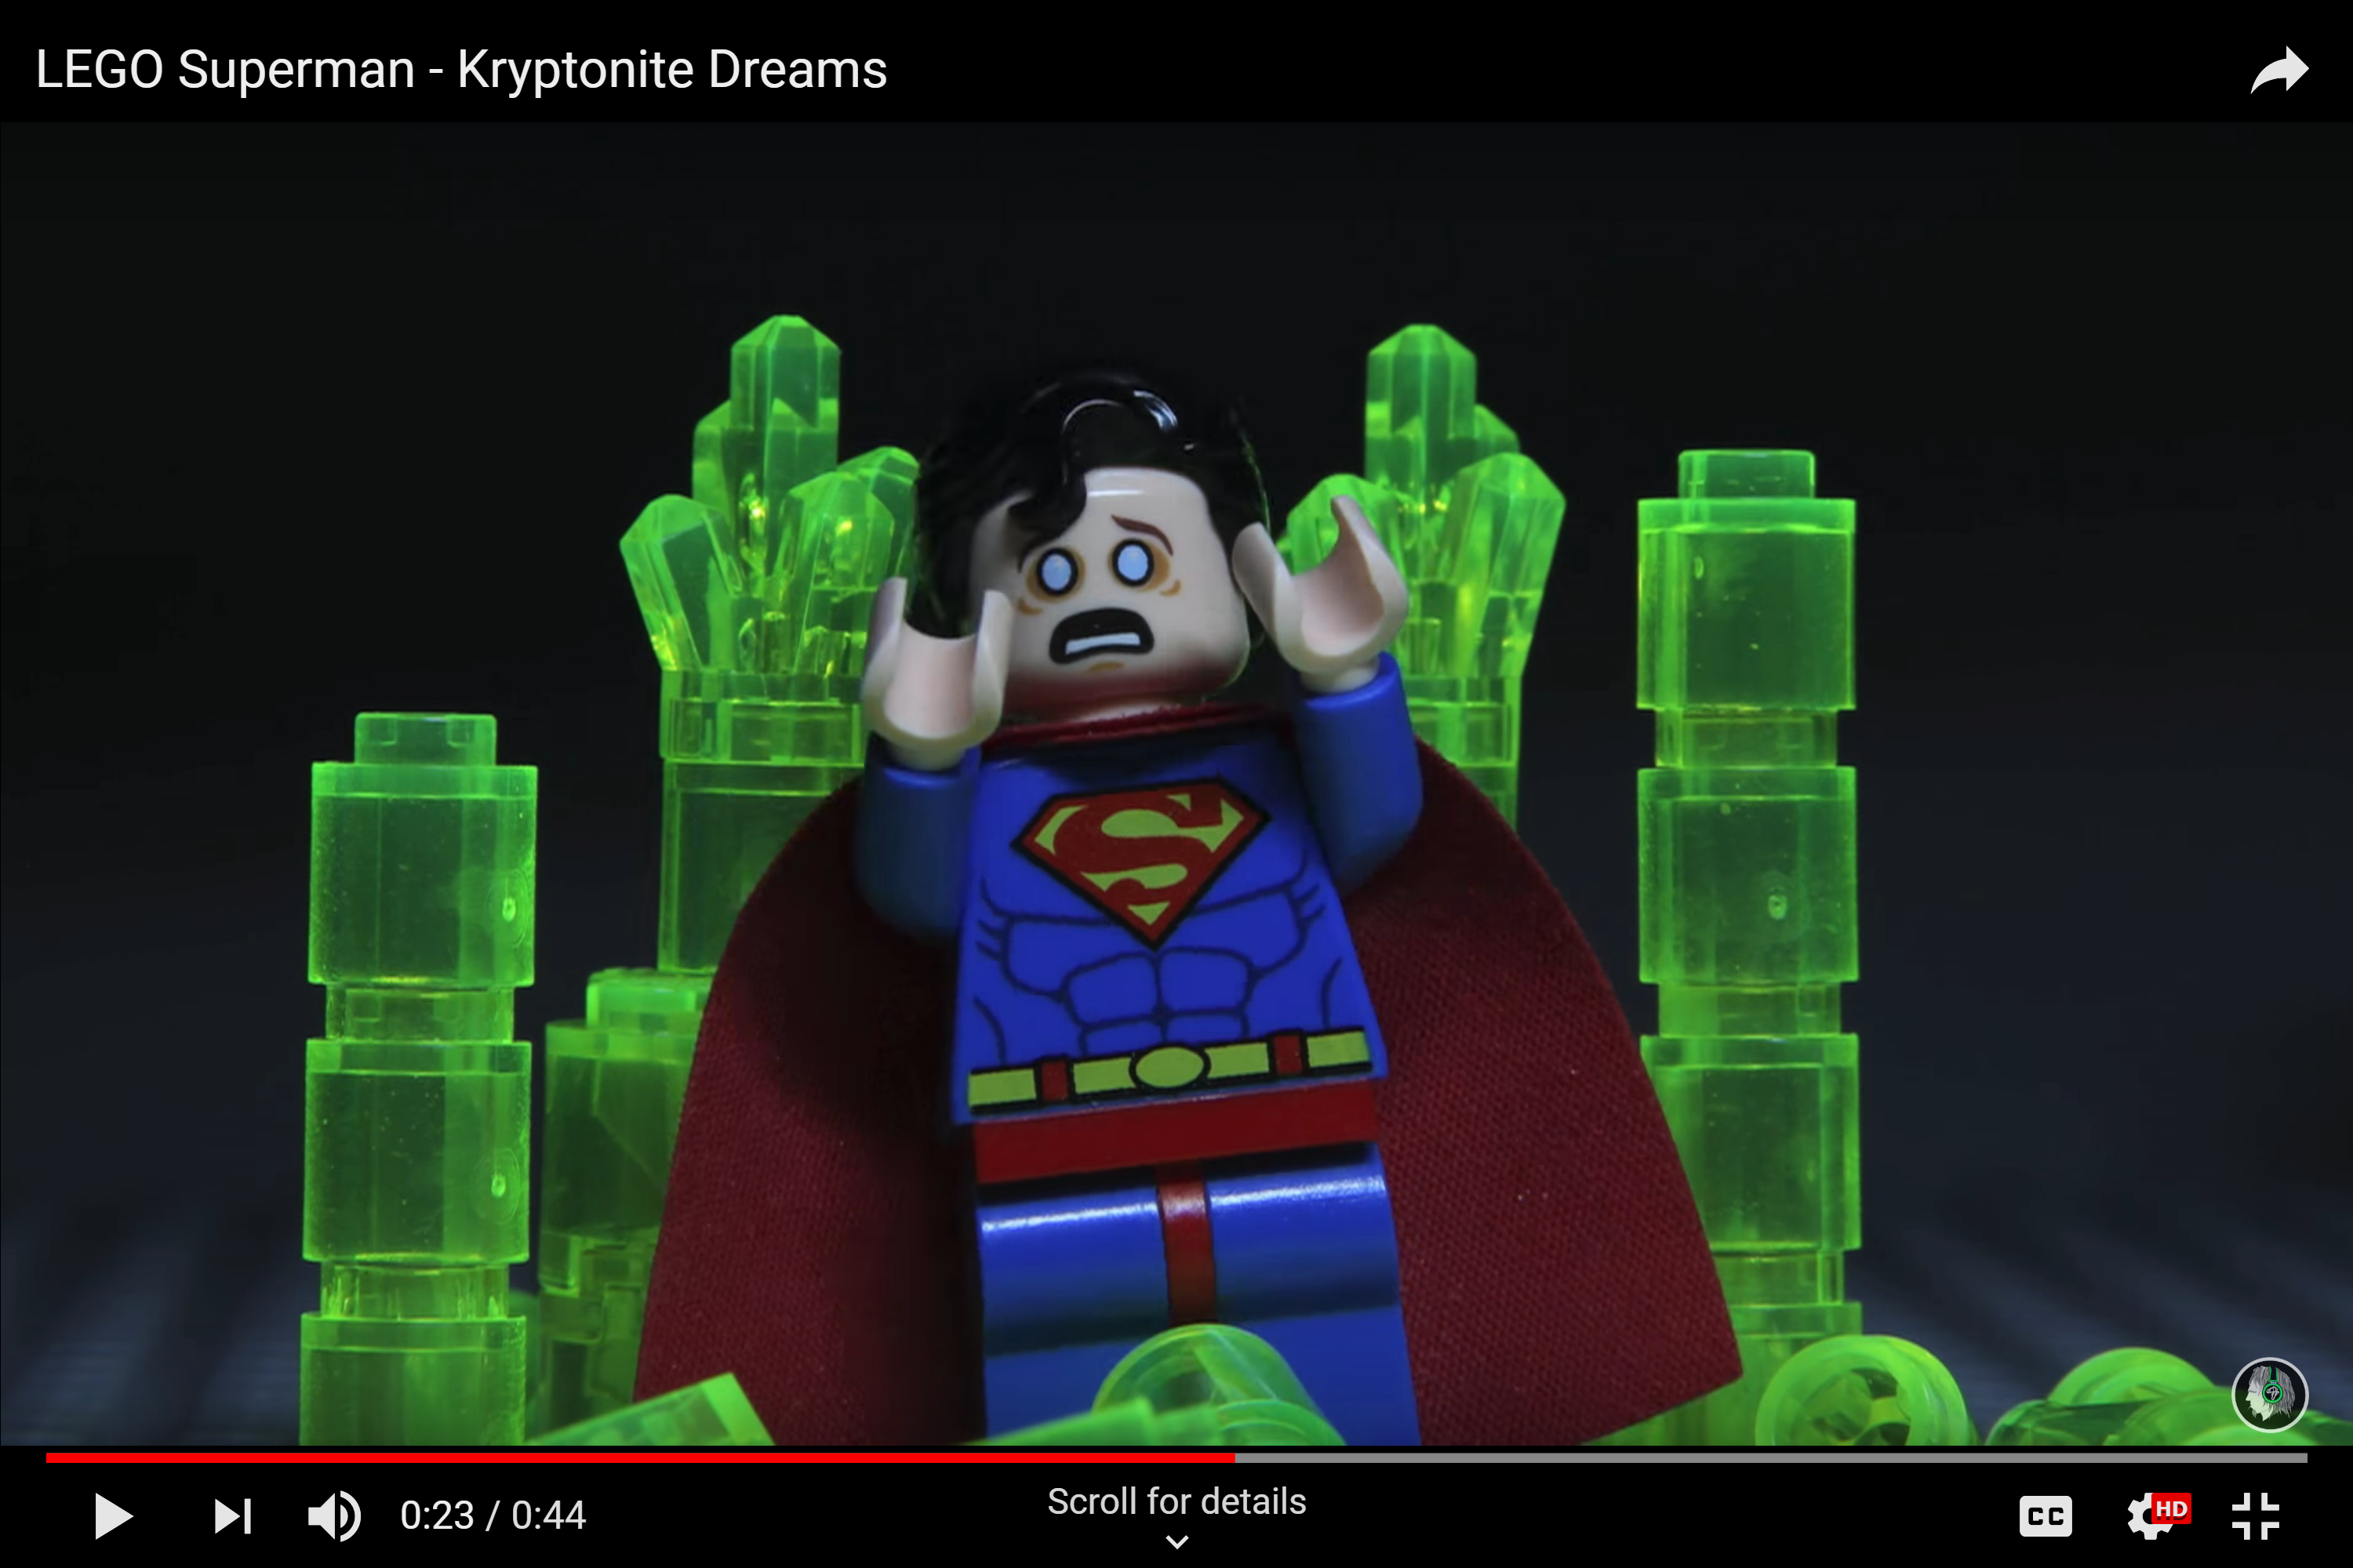
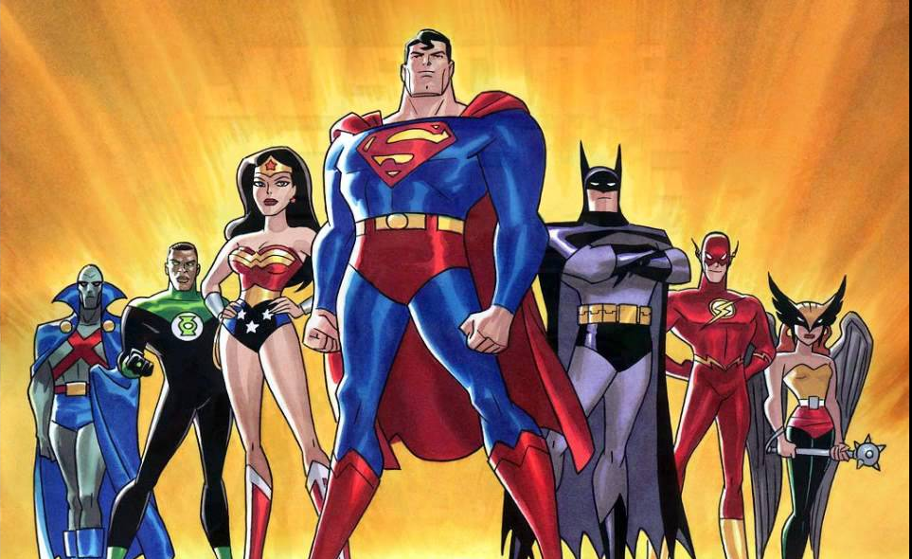


Team of all Kryptonians
Kryptonite →Identical Weakness
Justice League
Cover each others weakness

Slide 24
Thank you

Slide 25
Backup Slides

Slide 26

Inferring Correct Answer with NISQ Model
Quantum
Computer
Input Program
30%
Frequency
20%
20%
15%
10%
5%
S1
S2
S3
S4
S5
S6
Output Strings
Inference: Pick output with highest frequency of occurrence

Slide 27
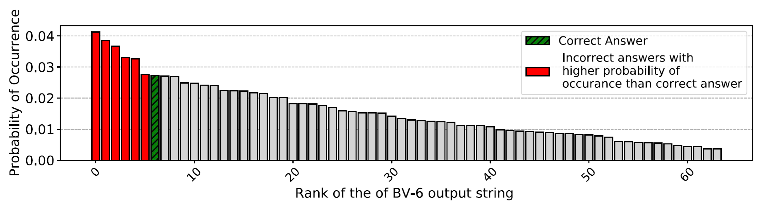
Running Bernstein Vazirani (BV) on IBMQ-14
Experiment with 8192 shots → Batch
BV-6 → Bernstein Vazirani Algorithm with 6-bit Key

Slide 28
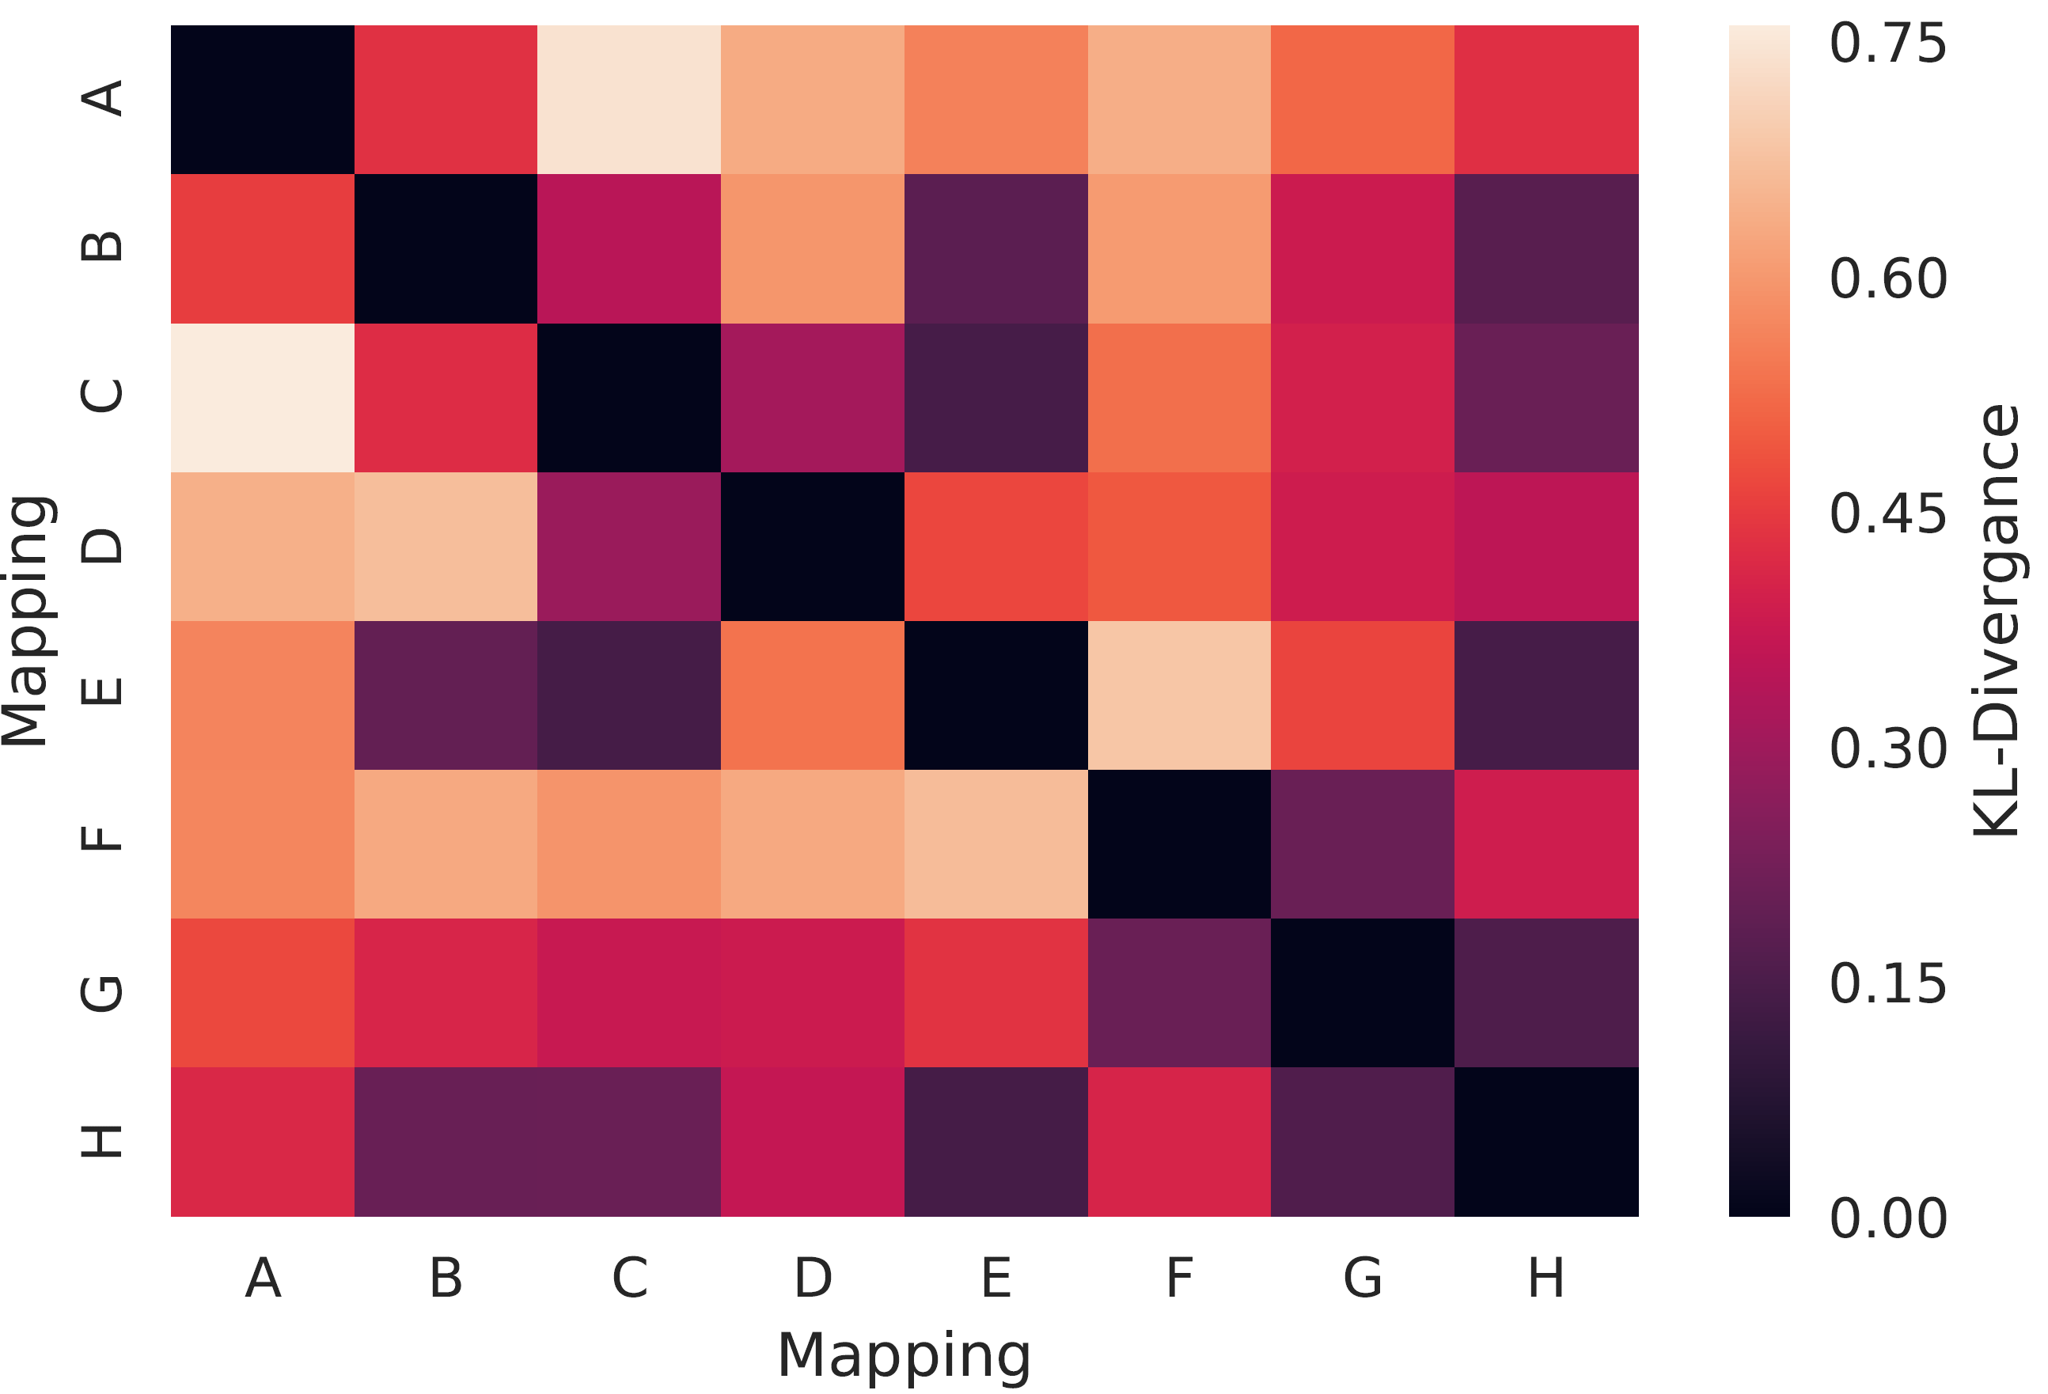
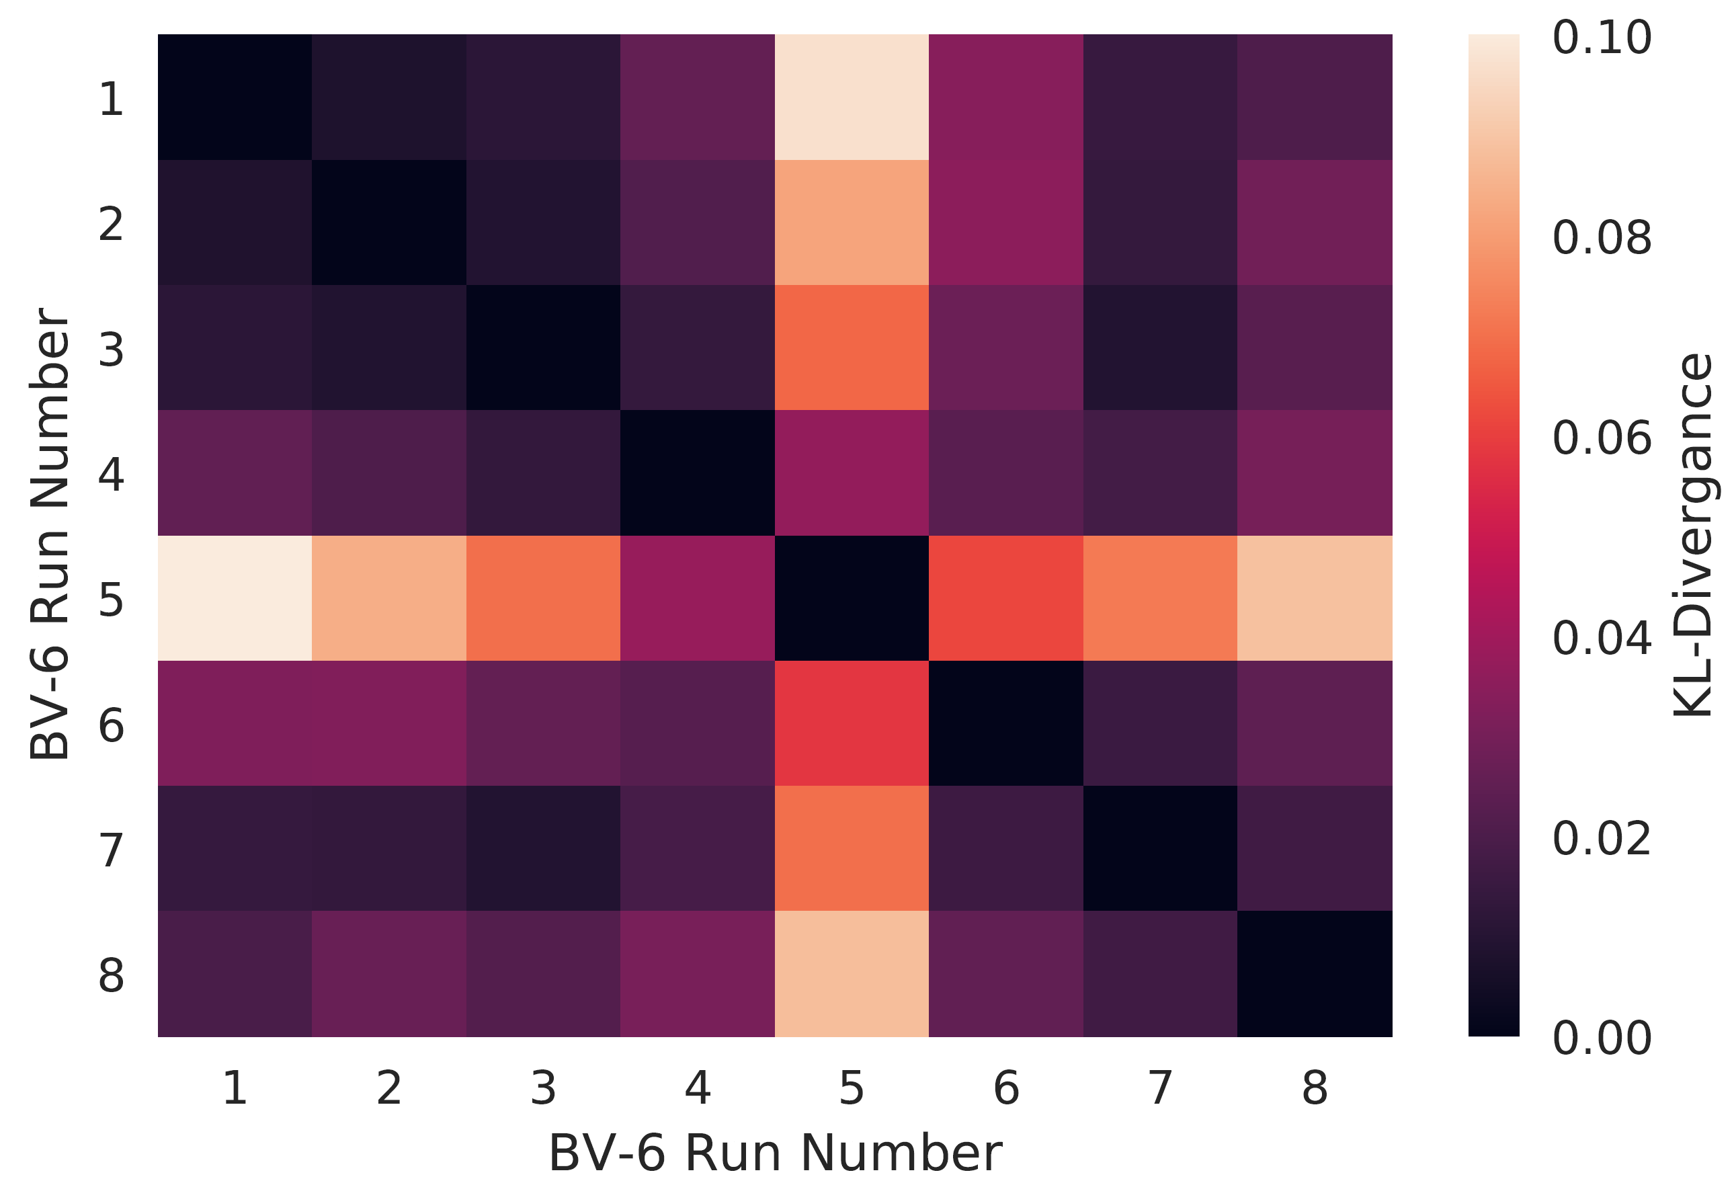
Heatmap – Diversity in Mapping
One Mapping for all
Four mappings
High Similarity (Identical Errors)
Low Similarity
(Different Errors)
Notes:
How diversity helps -- cartoon

Slide 29
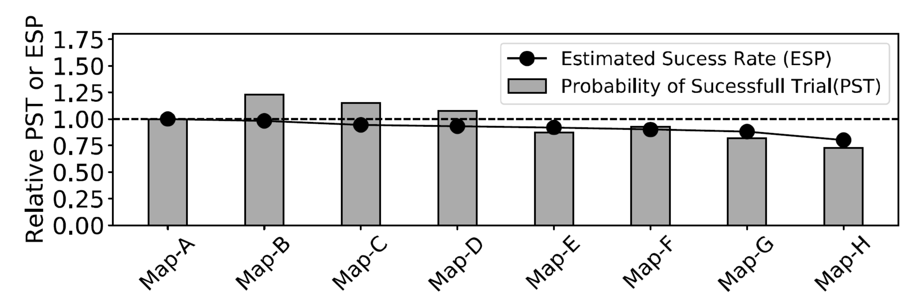
ESP vs PST

Slide 30
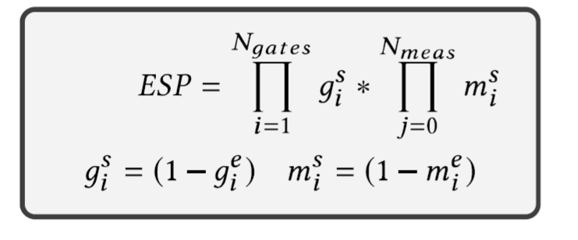
ESP vs PST
^{g}_{e} ^{→ gate error}
^{m}_{e} ^{→ Measurement error}

Slide 31
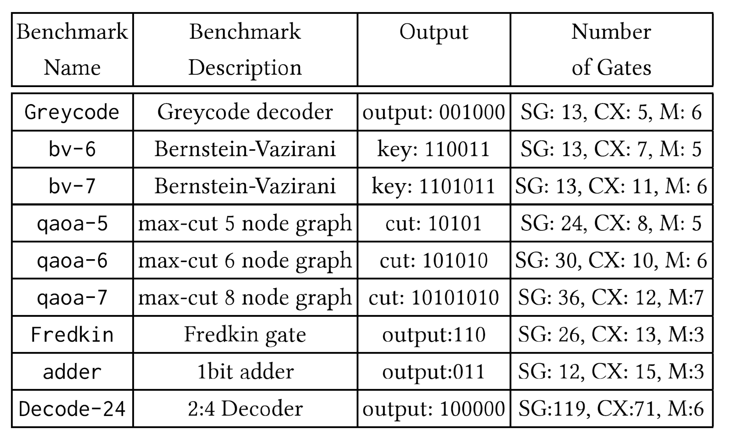
Benchmarks

Slide 32
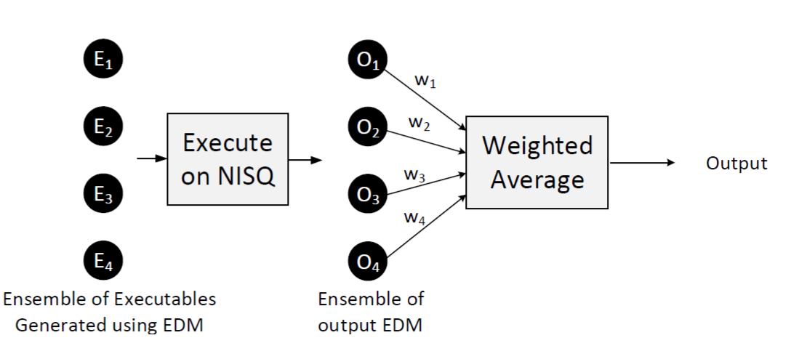
Weighted EDM

Slide 33
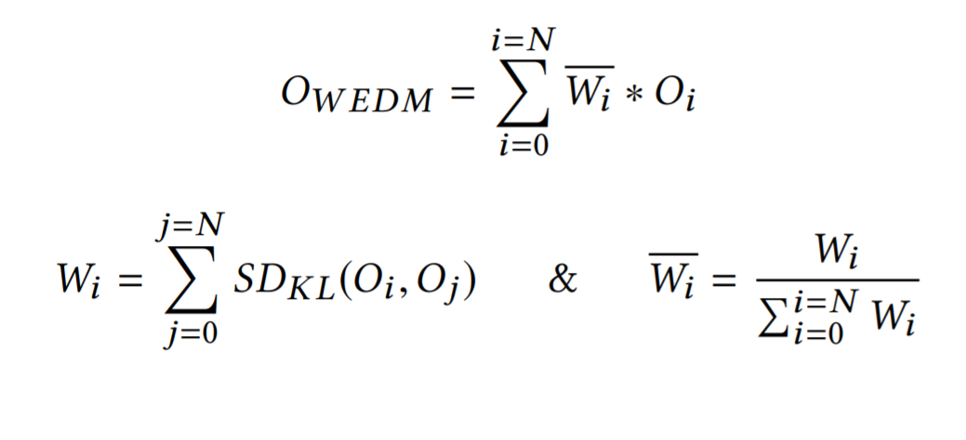
Weighted EDM

