Slide 1






HYDRA: Enabling Low-Overhead Mitigation of Rowhammer
at Ultra-Low Thresholds via Hybrid Tracking
Moinuddin Qureshi
Aditya Rohan, Gururaj Saileshwar, Prashant Nair

Slide 2

Rowhammer Attacks
DRAM Scaling for Increased Capacity
More Inter-Cell Interference
DRAM
(old)
DRAM
(new)
Notes:
- With DRAM Scaling for increased capacity, DRAM cells are so close that activity on cells in one DRAM row causes charge leakage from cells in neighboring rows.
Rowhammer attacks exploit this phenomenon by accessing a DRAM row rapidly in a short window of time, that ends up causing bit-flips in neighboring rows. Essentially, this allows an adversarial software to flip bits in memory without accessing them.
Adversarial software can gain kernel-level privileges, by tampering the page-tables [Orig], or sensitive binaries like the sudo binary [Another-Flip], and even infer data in neighboring rows based on whether they flip or not [RamBleed].

Slide 3

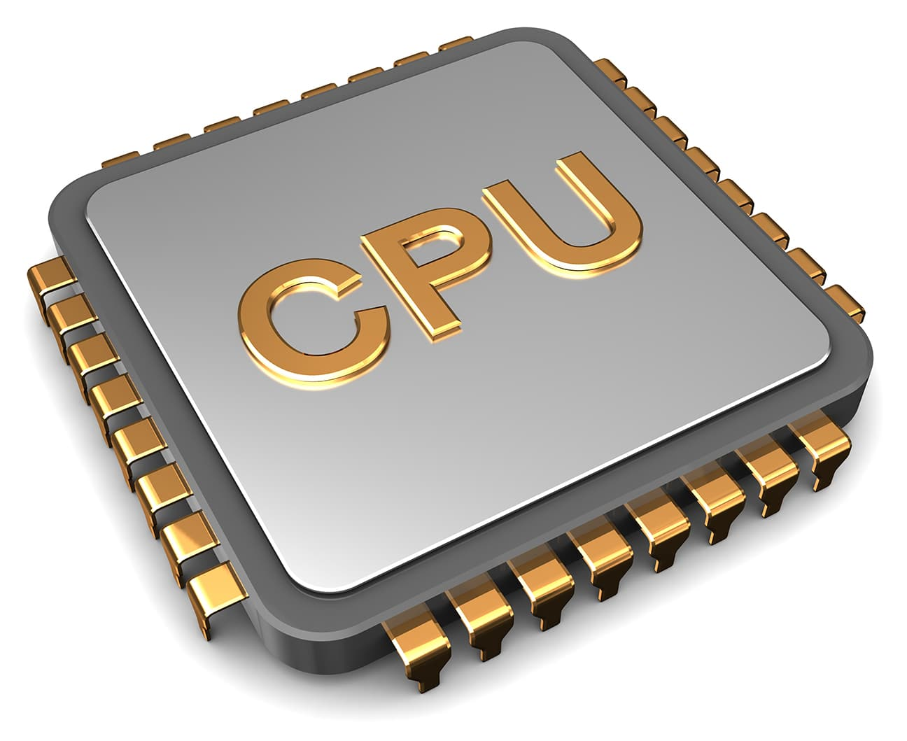
Rowhammer Attacks
DRAM Scaling for Increased Capacity
More Inter-Cell Interference
Rowhammer Attack
DRAM
(old)
Row of Cells (8KB)
Aggressor Row
Row
Rapid
Accesses
Row
Victim Row
Aggressor Row
Row
DRAM
(new)
DRAM
Bit-Flips in Neighboring Rows
Notes:
- With DRAM Scaling for increased capacity, DRAM cells are so close that activity on cells in one DRAM row causes charge leakage from cells in neighboring rows.
Rowhammer attacks exploit this phenomenon by accessing a DRAM row rapidly in a short window of time, that ends up causing bit-flips in neighboring rows. Essentially, this allows an adversarial software to flip bits in memory without accessing them.
Adversarial software can gain kernel-level privileges, by tampering the page-tables [Orig], or sensitive binaries like the sudo binary [Another-Flip], and even infer data in neighboring rows based on whether they flip or not [RamBleed].

Slide 4
Rowhammer Attacks
Rowhammer Attack
loop:
mov (X), %eax
mov (Y), %ebx
clflush (X)
clflush (Y)
mfence
jmp loop
Row of Cells (8KB)
Aggressor Row
Row
Rapid
Accesses
Row
Victim Row
Aggressor Row
Row
Software Adversary Can Flip Bits in Page Tables &
Gain Kernel Privileges (Take Over a System)
DRAM
Bit-Flips in Neighboring Rows
[Seaborn+, Blackhat’15]
Notes:
- With DRAM Scaling for increased capacity, DRAM cells are so close that activity on cells in one DRAM row causes charge leakage from cells in neighboring rows.
Rowhammer attacks exploit this phenomenon by accessing a DRAM row rapidly in a short window of time, that ends up causing bit-flips in neighboring rows. Essentially, this allows an adversarial software to flip bits in memory without accessing them.
Adversarial software can gain kernel-level privileges, by tampering the page-tables [Orig], or sensitive binaries like the sudo binary [Another-Flip], and even infer data in neighboring rows based on whether they flip or not [RamBleed].

Slide 5
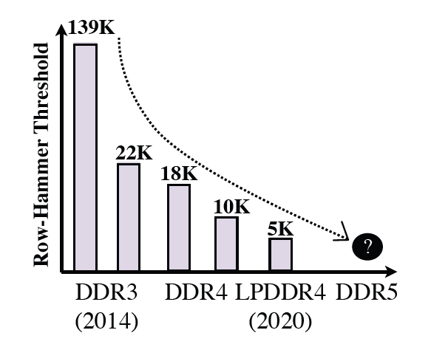
Rowhammer is Getting Worse!
Rowhammer Threshold: Bitflips require activating at least one row TRH times
30x Reduction in TRH in 8 years!
Solutions must tolerate not only current TRH but future TRH (Our goal: TRH $≤\text{500)}$
Notes:
- With DRAM Scaling for increased capacity, DRAM cells are so close that activity on cells in one DRAM row causes charge leakage from cells in neighboring rows.
Rowhammer attacks exploit this phenomenon by accessing a DRAM row rapidly in a short window of time, that ends up causing bit-flips in neighboring rows. Essentially, this allows an adversarial software to flip bits in memory without accessing them.
Adversarial software can gain kernel-level privileges, by tampering the page-tables [Orig], or sensitive binaries like the sudo binary [Another-Flip], and even infer data in neighboring rows based on whether they flip or not [RamBleed].

Slide 6
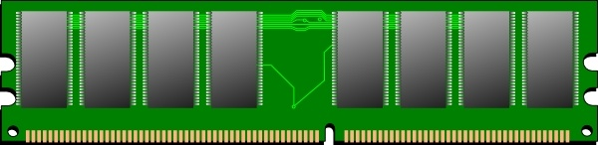
Typical Mitigation for Rowhammer
Targeted Row Refresh (TRR) in DDR4 (2015)
Track Aggressor Rows
Mitigative Action
1
2
Victim Row
Refresh
Aggressor Row
Victim Row
DRAM

Slide 7
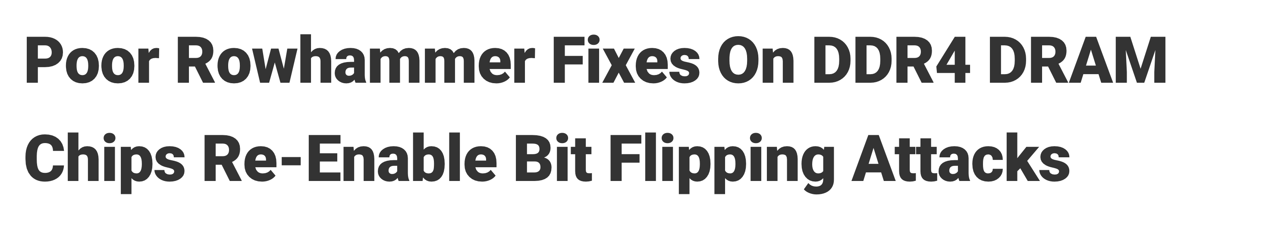
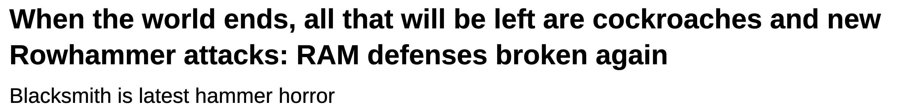
Typical Mitigation for Rowhammer
Targeted Row Refresh (TRR) in DDR4 (2015)
Track Aggressor Rows
Mitigative Action
1
2
TRResspass Breaks TRR Tracker [Frigo+, SP’20]
Victim Row
Refresh
Aggressor Row
Source: The Hacker News
Victim Row
Blacksmith Attack: All DDR4 DRAM Vulnerable [Jattke+, SP’22]
DRAM
Source: The Register

Slide 8
Why Trackers Break?
Refresh Period: 64ms, Row-Cycle Time: 45ns
Activation Budget Per Bank: ~1.4 Million
Max. Attack Rows
RH Threshold | 1-Bank | 32-banks
100,000 | 14 | 448
10,000 | 140 | 4.5K
1,000 | 1400 | 45K
Victim Row
Aggressor Row
Victim Row
DRAM
The number attack rows increases inversely to Threshold, so does tracker state

Slide 9
Pitfall of SRAM-Based Trackers
SRAM-tables can be in memory controller (CAT) or inside DRAM chip (TRR)
Overheads for 16GB Rank (16 Banks, 8KB Rows)
RH Threshold | Graphene (100% CAM) | TWiCE | CAT | D-CBF (Blacklist only) | Naive
32K | 5KB | 37KB | 25KB | 53KB | 3.8MB
500 | 340KB | 2.3MB | 1.5MB | 768KB | 2.3MB
250 | 679KB | >2MB | >2MB | 1.5MB | 2MB
Our goal is < 64KB SRAM per Rank
SRAM-Based trackers incur impractical SRAM overheads at ultra-low thresholds

Slide 10
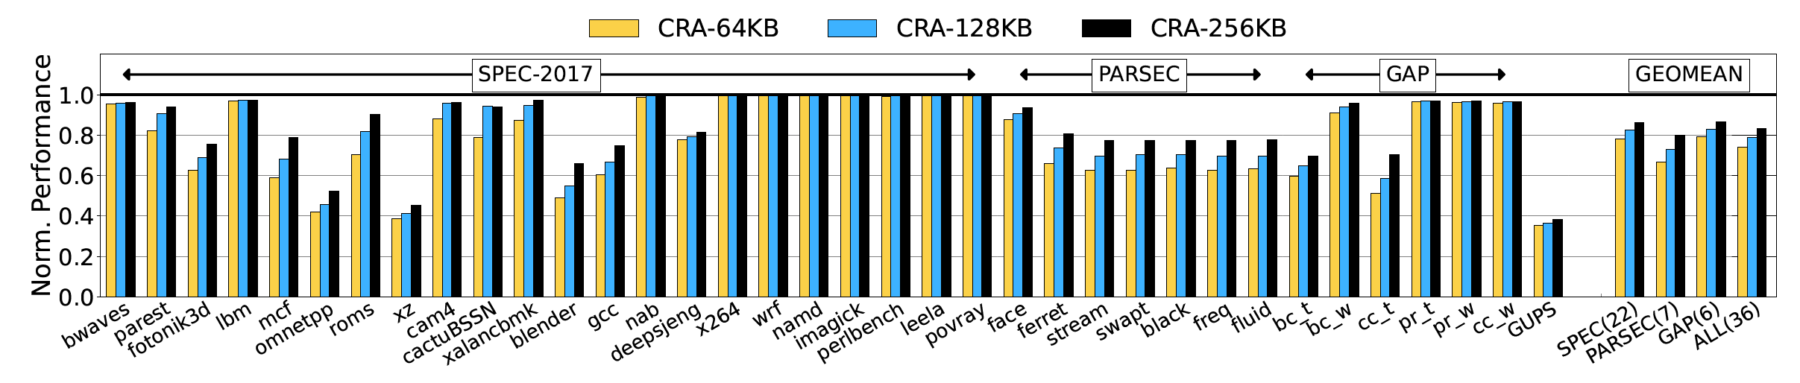
Pitfall of DRAM-Based Trackers
Counter-Based Row Activation [Kim, Nair, Qureshi - CAL’14]:
Keep counters for ALL rows in a dedicated region in DRAM, cache counter-lines on-chip
DRAM-based trackers incur low SRAM storage but high performance overhead (25%)

Slide 11

Goal
Develop secure and low-cost Rowhammer mitigation:
  Effective at Ultra-Low thresholds (500 or below)
  Low SRAM overhead (<64KB per rank)
  Low performance overhead (< 1%)
  No changes to DRAM arrays or memory interfaces

Slide 12
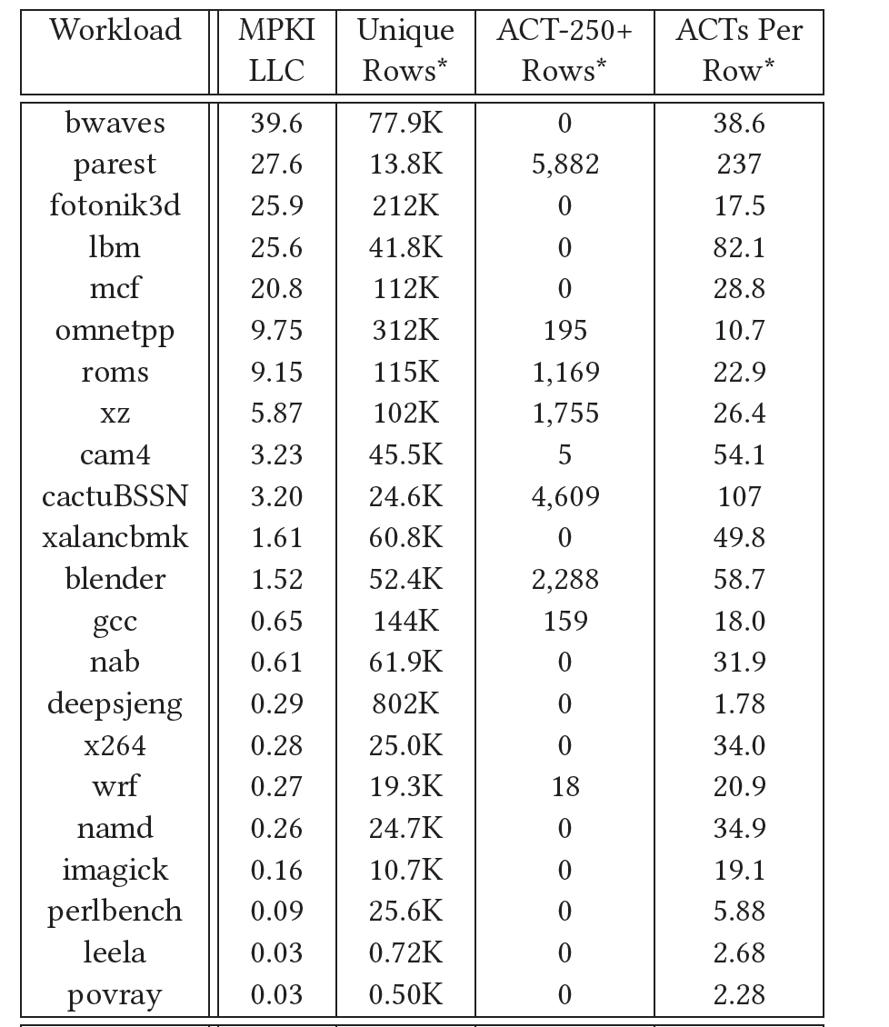
Observation and Insight
Rowhammer: Race against time (64 ms)
  Access many rows few times ✓
  Access few rows many times ✓
  Access many rows many times ✗
Applications (within 64ms):
- Access 100k+ rows
- On average, few 10s of ACT/row
- Few thousand rows have 250+ ACT
Insight:
- Have ability to track all rows (DRAM)
- Use SRAM to filter out common-case

Slide 13
HYDRA: Hybrid Tracker
HYDRA: SRAM for group-tracking, and DRAM for per-row tracking (cached)
Memory Controller (SRAM)
DRAM
Row-ID
Address
Space
Group Count
Table (GCT)
Row Count
Cache (RCC)
Row Count
Table (RCT)
HYDRA uses DRAM to get scalable tracking, and SRAM to avoid performance overheads

Slide 14
HYDRA: Operation
Assume: Hydra Threshold = 250, Group Threshold= 200
Miss
No
Hit, Ctr++
Yes, Ctr++
DRAM
Address
Space
Row-ID
< 200?
Row Count
Cache (RCC)
Group Count
Table (GCT)
Row Count
Table (RCT)
32KB SRAM
(90.7% Accesses)
24KB SRAM
(9% Accesses)
4MB DRAM
(0.3% Accesses)
The GCT filters most of the counter checks, less pressure on RCC, minimal RCT access

Slide 15
HYDRA: Reset and Set
When GCT-entry reaches 200
Set relevant RCT-entries to 200
Every 64ms, Reset SRAM state
Memory Controller (SRAM)
DRAM
Row-ID
Address
Space
Up 200?
Group Count
Table (GCT)
Row Count
Cache (RCC)
Row Count
Table (RCT)
If a Row is accessed continuously, first mitigation may be at 50, then 250 each
HYDRA uses intelligent indexing to reduce RCT set overhead (128 counters in two lines)

Slide 16
Security Analysis
HYDRA Threshold is set to TRH/2 due to periodic reset (TH=250, TRH=500)
Proof that HYDRA issues a mitigation at-least once per TRH
Protection for RCT rows (their counters kept in SRAM, 500 bytes)
Protection against Half-Double (mitigations increment count for victim)
HYDRA works with any mitigating action (BH/RRS): Refresh 2 rows on each side
Security NOT dependent on pattern
For detailed security analysis, please see the paper

Slide 17
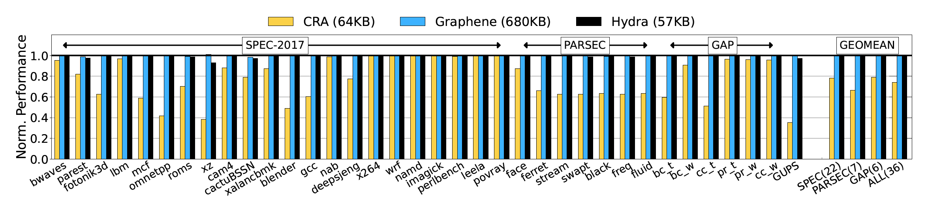
Results
Config: 8-core OOO, 32GB DRAM (2 Ranks, 8KB Row-Buffer)
HYDRA has negligible slowdown (0.7%) and low SRAM overheads (57KB for two ranks)

Slide 18
Say Hello! to DDR5
SRAM overheads for 32GB (2 Ranks) for DDR4 (current) and DDR5 (soon)
Scheme | DDR-4 (16 banks/rank) | DDR-5 (32 banks/rank)
Graphene | 640 KB (CAM) | 1.3 MB (CAM)
TWiCE | 4.6 MB | 9 MB
CAT | 3 MB | 6 MB
D-CBF | 1.5 MB | 1.5 MB
HYDRA | 56.5 KB | 56.5 KB
DRAM overhead of HYDRA is negligible (4MB out of 32GB, 0.01%)
HYDRA provides scalable Rowhammer mitigation even for DDR5

Slide 19
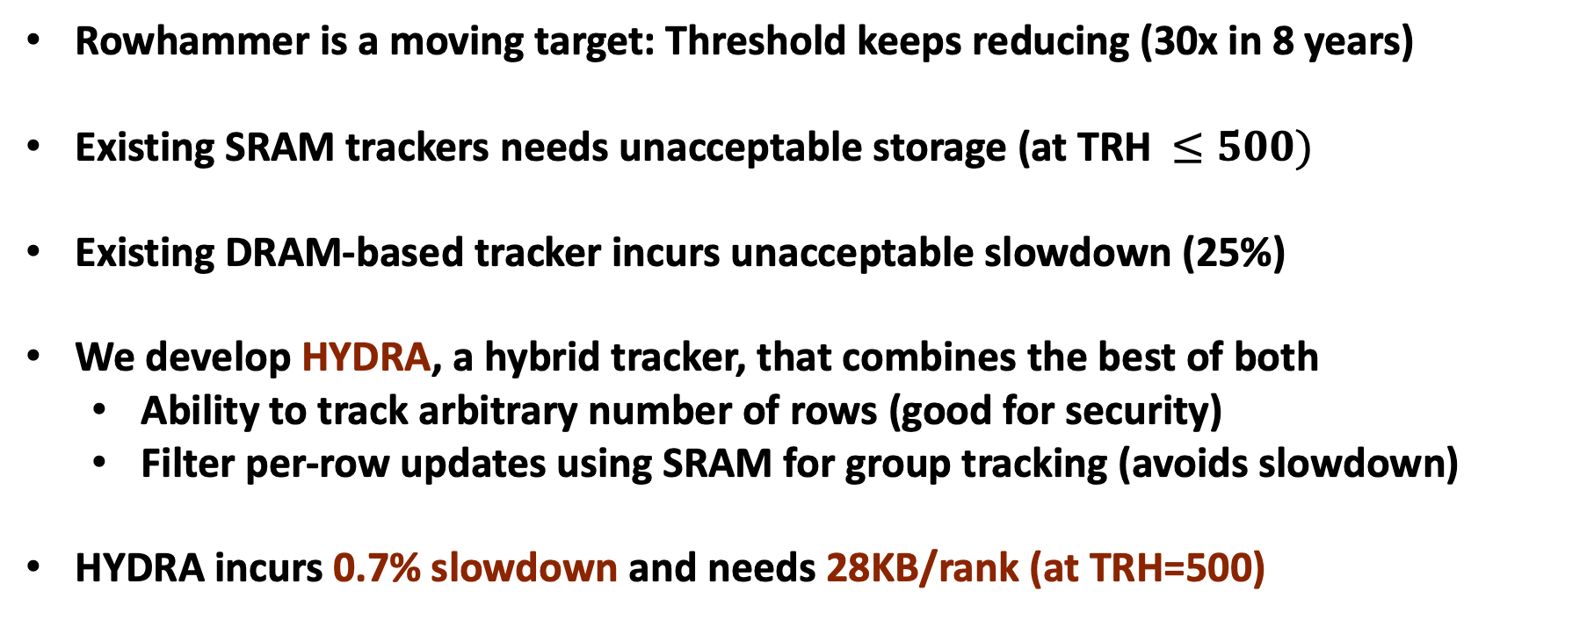
Conclusion
Rowhammer is a moving target: Threshold keeps reducing (30x in 8 years)
Existing SRAM trackers needs unacceptable storage (at TRH $≤500)$
Existing DRAM-based tracker incurs unacceptable slowdown (25%)
We develop HYDRA, a hybrid tracker, that combines the best of both
  Ability to track arbitrary number of rows (good for security)
  Filter per-row updates using SRAM for group tracking (avoids slowdown)
HYDRA incurs 0.7% slowdown and needs 28KB/rank (at TRH=500)

Slide 20
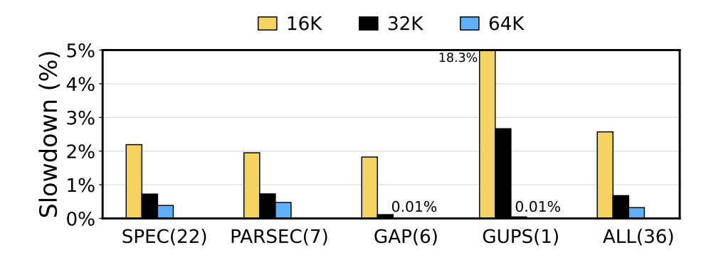
Sensitivity to GCT Capacity
We use a default GCT of 32K
A larger GCT virtually eliminates all slowdown (except for mitigating actions)

Slide 21
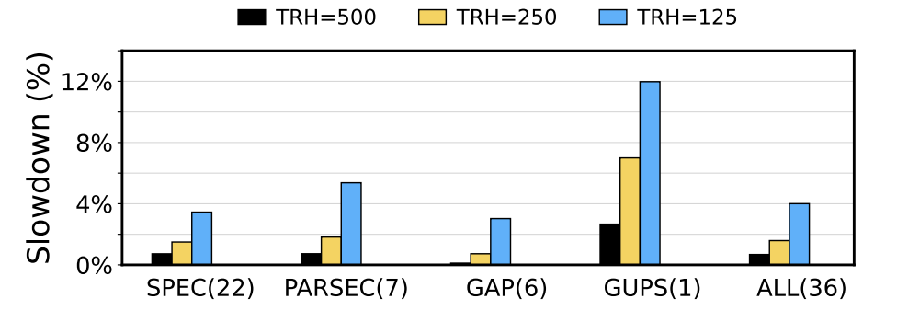
Sensitivity to RH Threshold
Structures scaled 2x for TRH=250, and 4x for TRH=125
HYDRA has can provide scalable Rowhammer mitigation even at low threshold

Slide 22
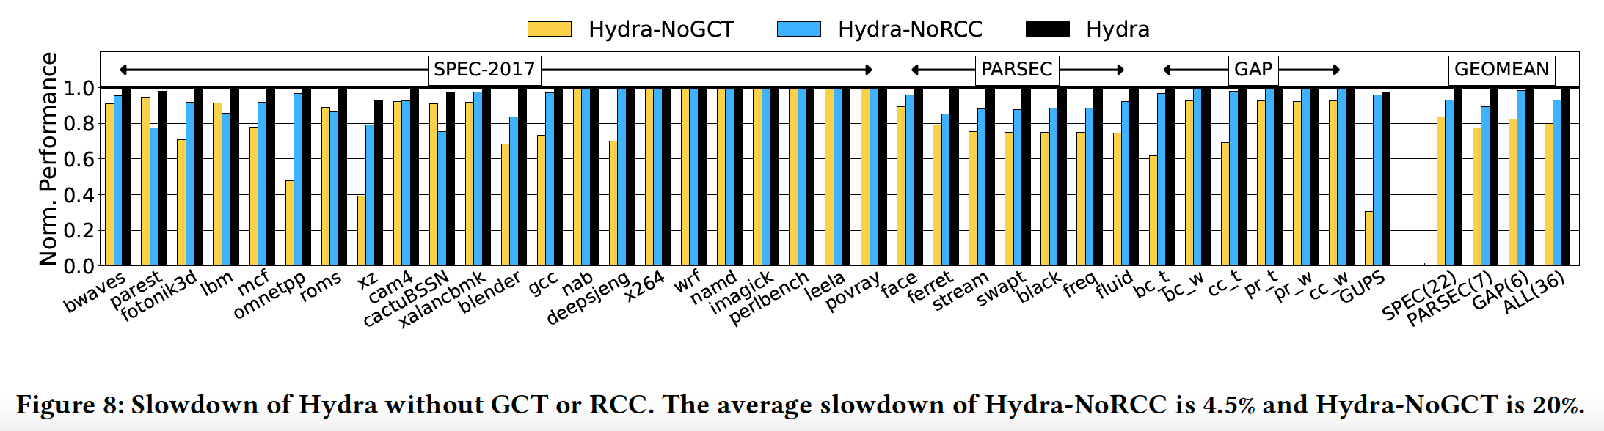
GCT vs RCC: Which One?
GCT is the primary source of effectiveness (filtering 90% of the accesses)

Slide 23
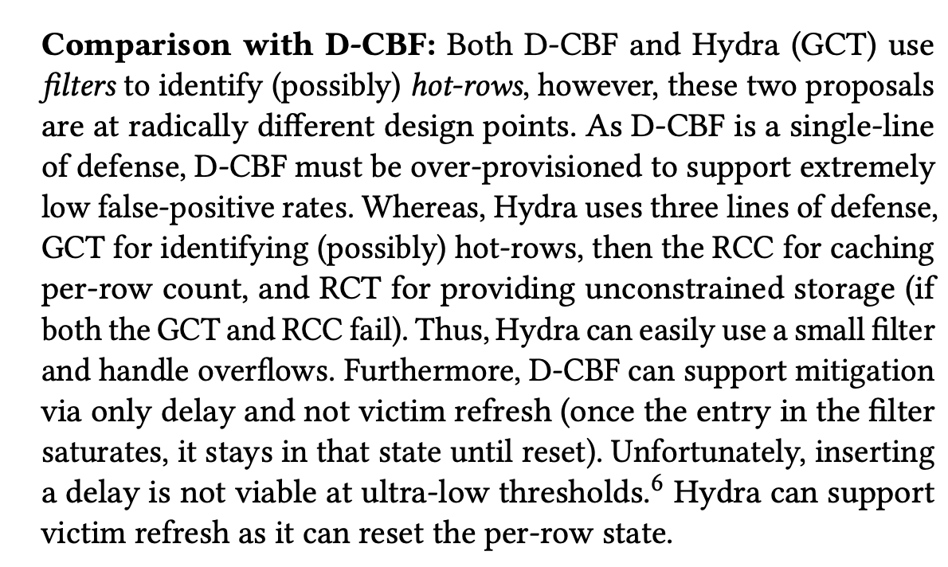
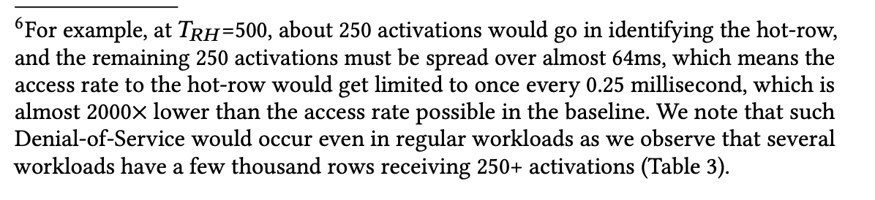
D-CBF

