Slide 1

Protecting DNNs from Theft using an Ensemble of Diverse Models
ICLR 2021
Sanjay Kariyappa¹
Atul Prakash²
Moinuddin Qureshi¹
1
2
1

Slide 2

Model Stealing Attacks: Security Implications
Compromises model confidentiality
Adversarial Attacks
Black-Box
Target Model
Clone Model
Membership inference, Model inversion attacks
2

Slide 3
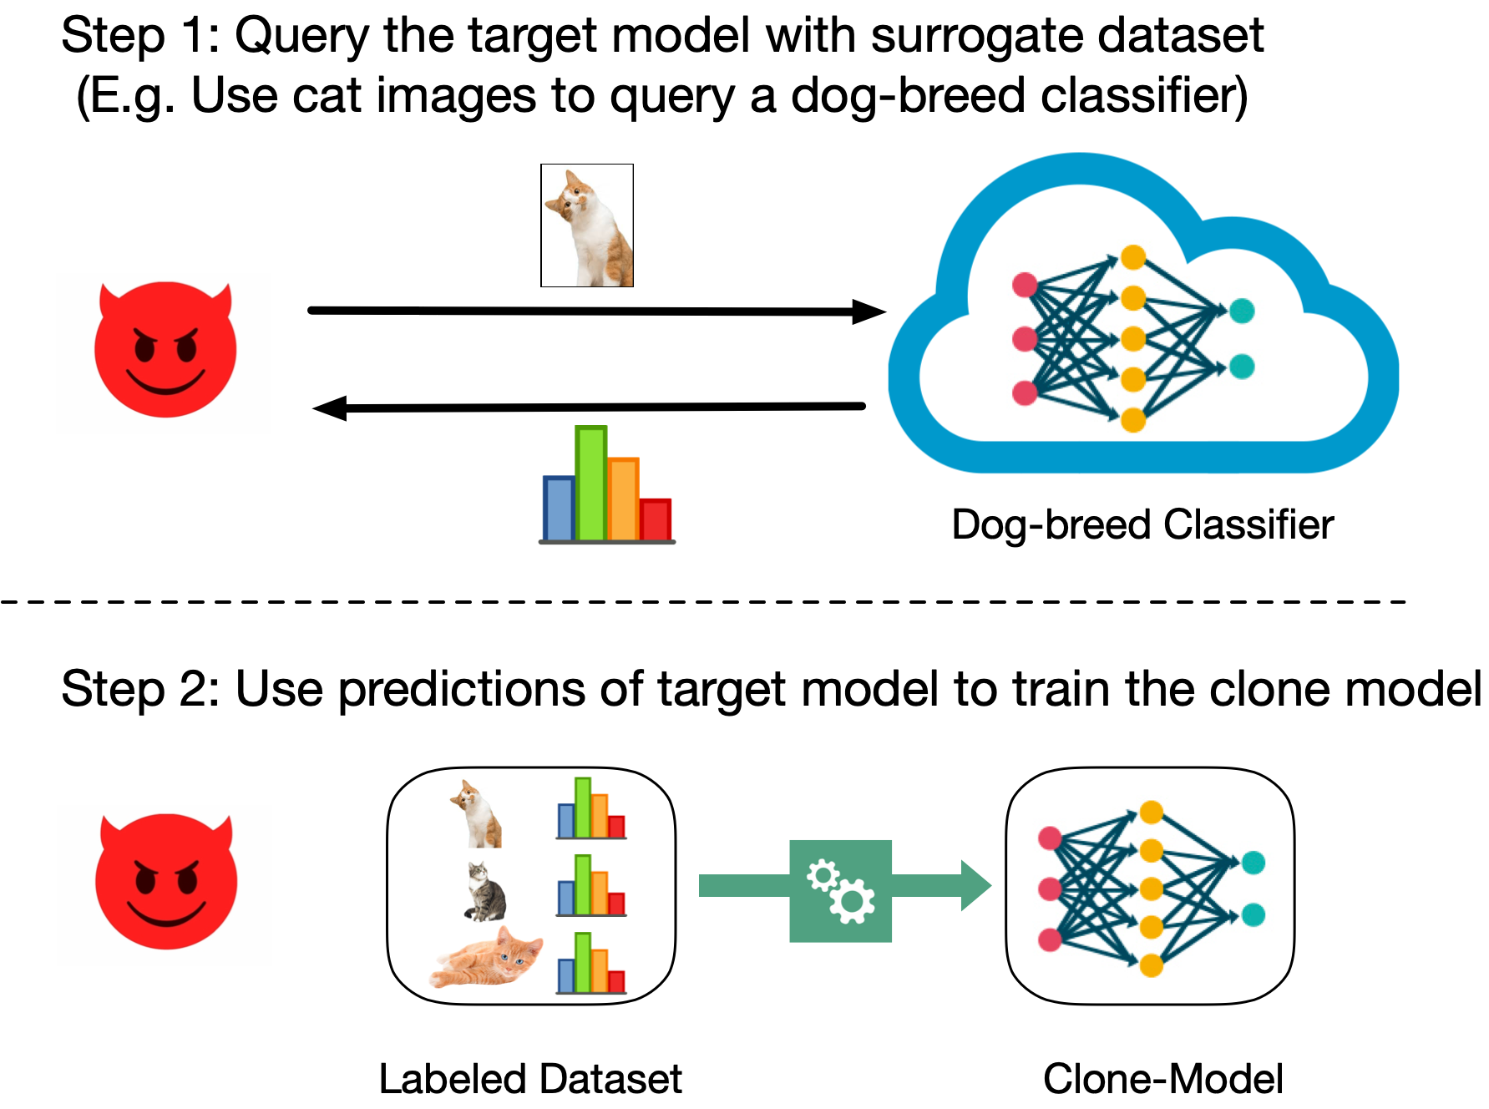
Model Stealing Using Surrogate or Synthetic Datasets
3
Our Goal: Develop a defense against model stealing attacks in the data-limited setting

Slide 4


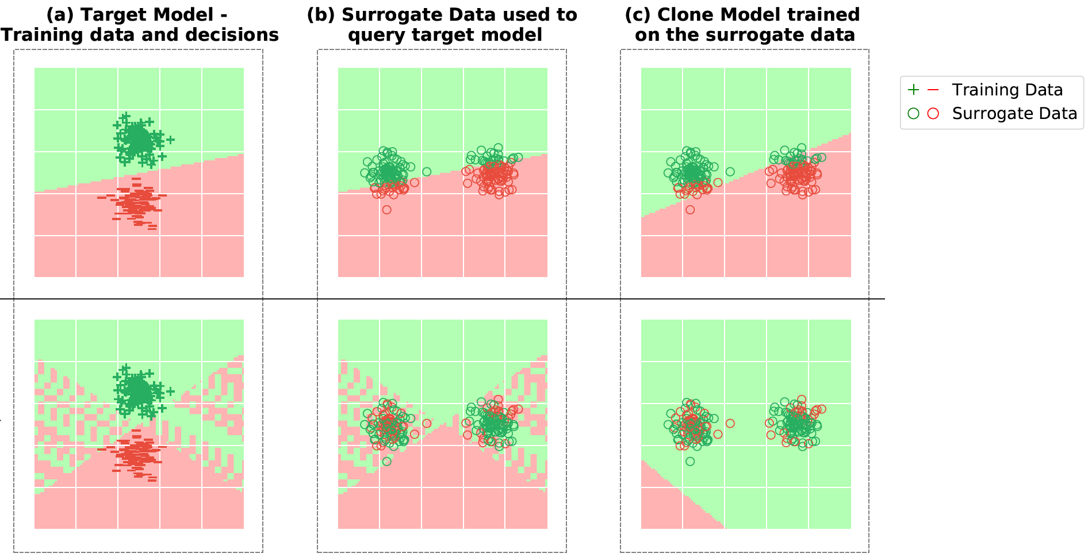
Observation: Attacks (like KnockoffNets¹, JBDA²) assume that the target model under attack is continuous.
Insight: Discontinuous target models are harder to clone using a continuous clone model.
Target Model
Surrogate Data
Clone Model
Continuous Model
(undefended)
Discontinuous Model
(EDM)
How do we create a target model discontinuous predictions while providing high accuracy?
[1] Knockoff Nets: Stealing functionality of black-box models. Conference on Computer Vision and Pattern Recognition, 2019, Orekondy et al.
[2] Practical black-box attacks against machine learning, 2017 ACM on Asia conference on computer and communications security, Papernot et al.
4

Slide 5

Observation: Attacks assume that the target model under attack is continuous.
Insight: Efficacy of these attacks reduces if the target model is discontinuous.
Solution: We develop Ensemble of Diverse models (EDM) to create discontinuous predictions while providing high accuracy.
5

Slide 6


Solution
Training: Train Ensemble of Diverse models (EDM)
Inference: Use EDM to create discontinuous predictions.
6

Slide 7


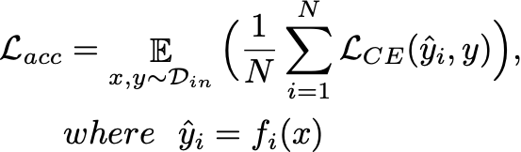
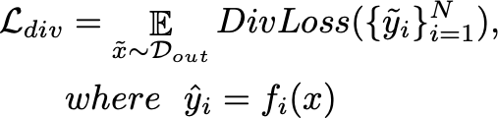



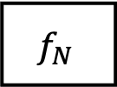


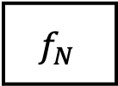
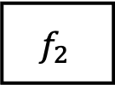

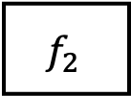

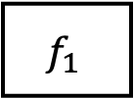
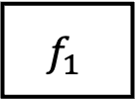

Training Ensemble of Diverse Models
1. Accuracy Objective (In-Distribution data)
2. Diversity Objective
(Out-of-Distribution Data)
$$x$$
$$x$$
$$x$$
$$\tilde{x}$$
$$\tilde{x}$$
$$\tilde{x}$$
$$x, y∼D_{in}$$
$\tilde{x}$ $∼D_{out (aux)}$
$$f_{1}$$
$$f_{2}$$
…..
$$f_{N}$$
$$f_{1}$$
$$f_{2}$$
$$f_{N}$$
…..
9

Slide 8


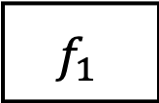

Using EDM to create Discontinuous Predictions
Selector
Input
Hash
$$f_{1}$$
#
$$f_{2}$$
$$f_{N}$$
$$x$$
10

Slide 9
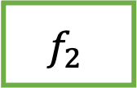



Using EDM to create Discontinuous Predictions
Selector
Input
Hash
$$f_{1}$$
#
$$f_{2}$$
$$f_{N}$$
$${y_{out}= f}_{index}(x)$$
$$x$$
$$H(x)$$
$$index=1+(H\left(x\right)\%N)$$
Discontinuous Predictions: Use different models in EDM to service different inputs.
10

Slide 10
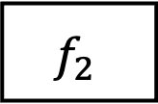


Perceptual Hash to deter Adaptive Attacks
Perceptual Hash
Selector
Input
Hash
Hash
$$f_{1}$$
#
$$f_{2}$$
$$f_{N}$$
$${y_{out}= f}_{index}(x)$$
$$x$$
$$H(x)$$
$$index=1+(H\left(x\right)\%N)$$
Deter adaptive attacks: Use perceptual hashing for transformation invariance (please see paper for details)
10

Slide 11
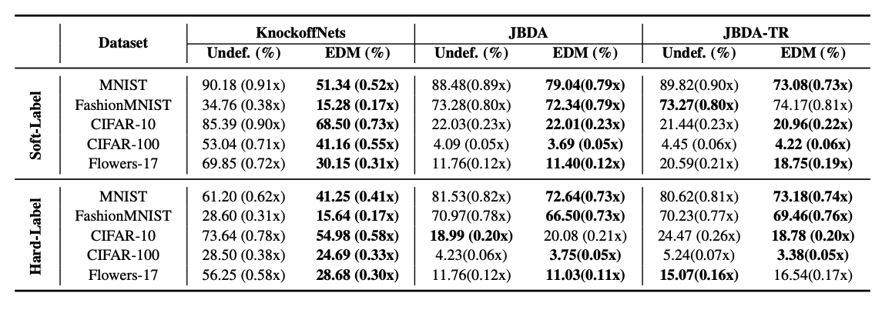
Results
Up to 40% reduction in the clone accuracy, with minimal impact (<1%) on the target accuracy
11
Thank You!

