Slide 1

MAZE: Data-Free Model Stealing Attack Using Zeroth-Order Gradient Estimation
CVPR 2021
Sanjay Kariyappa¹
Atul Prakash²
Moinuddin Qureshi¹
1
2

Slide 2

Model Stealing Attacks: Security Implications
Compromises model confidentiality
Adversarial Attacks
Black-Box
Target Model
Clone Model
Membership inference, Model inversion attacks

Slide 3
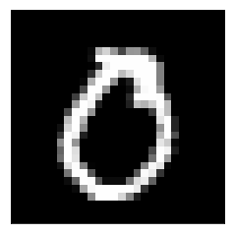
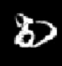


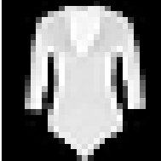
Overview of Model Stealing Attacks (data-limited setting)
Key Limitation: Existing attacks require a suitable surrogate dataset to work well.
Target Dataset | Surrogate Dataset | Clone Accuracy
MNIST | KMNIST | 98.21%
FashionMNIST | MNIST | 47.26%
Goal: Data-free model stealing attack.

Slide 4


Our proposal: MAZE
MAZE uses synthetic data from a Generative model to perform model stealing.
Target Model (T)
Generator (G)
Clone Model (C)

Slide 5
Problem with Generator Training
Black-Box Model
Target Model (T)
Generator (G)
Clone Model (C)
Solution: Use zeroth-order gradient estimation.

Slide 6
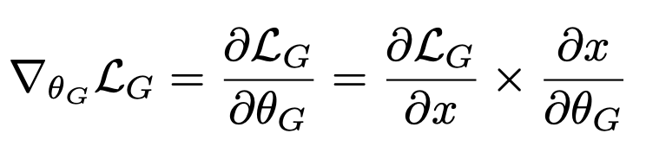
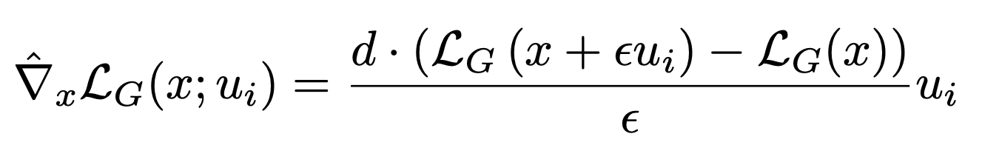
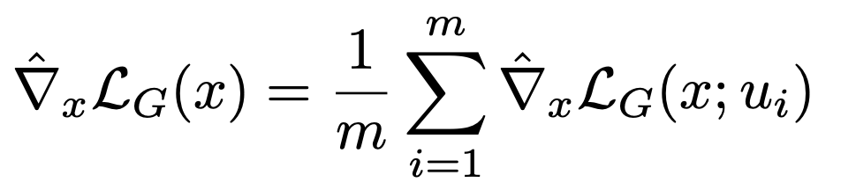

Zeroth Order Gradient Estimation
Target Model (T)
Forward Difference Method:
$$z$$
Generator (G)
Average Gradient Estimate:
Clone Model (C)

Slide 7
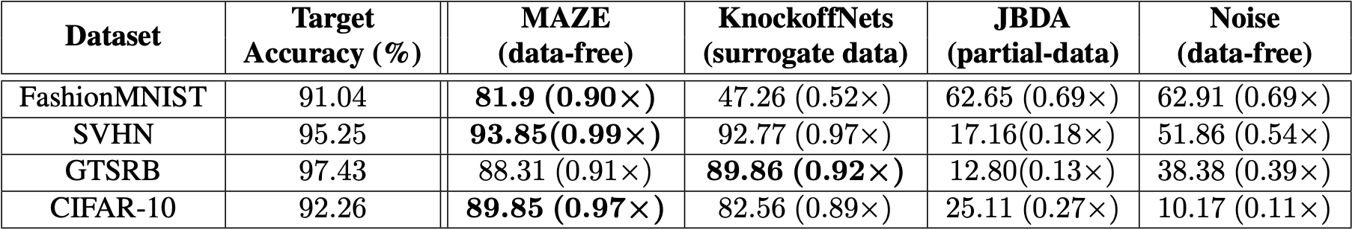
Results
Unlike KnockoffNets and JBDA, MAZE (our proposal) does not require any data.
MAZE obtains high clone accuracy (0.90× to 0.99×).

Slide 8


MAZE-PD: Extending MAZE to Partial Data Setting
In-distr. data
Critic (D)
$$z$$
Target Model (T)
Generator (G)
WGAN
Clone Model (C)

Slide 9
MAZE-PD: Extending MAZE to Partial Data Setting
In-distr. data
Critic (D)
Compared to MAZE, MAZE-PD achieves:
Near identical clone accuracy to the target (0.97x -1.0x vs 0.90x-0.99x for MAZE)
Reduces query cost by 2x-24x
$$z$$
Target Model (T)
Generator (G)
WGAN
Clone Model (C)
Thank You!

