Slide 1
NoT All QuBITs Are created Equal
Variability Aware Policies for NISQ Computers
ASPLOS 2019
Swamit Tannu
Moinuddin Qureshi
Notes:
Good afternoon I am swamit, Today I will talk about how we can improve reliability of
Near-term quantum computers by leveraging variability in the error-rates of qubits.
Intro: 4 min
Slide 1 : Benefit of Quantum, Quantum is Here (>50 qubit computers), Qubits are erroneous.
Slide 2 : NISQ - What is it ? What is the execution model?
Slide 3 : Compiler Policies of NISQ - Mapping / Allocation
Slide 4 : Baseline policy - minimize the swaps
Slide 5 : Problem/Shortcoming of Baseline - If there is a bad link, compiler will still take it. PST will drop. This is bad.
Slide 6 : Goal : We want to make the compile aware of errors and variation.
Characterization – 3 min
Design (Baseline + Proposal) - 5 min
Evaluation – 3 min
Conclusion – 1 min
Cheers,
Gururaj

Slide 2
Quantum Computers are Here!
Recent demonstrations
Quantum computers can speedup hard problems
Quantum Machine | Number of Qubits*
Google | 72
IBM | 50
Intel | 49
Rigetti | 19
IonQ | 11
100+ Years
Classical Computer
Execution Time
Quantum
Computer
Days
Problem Size
* Under test , fabricated, or announced
QC with 10+ qubits are here, QC with 100+ qubits expected soon

Slide 3
Quantum Computing: Background
QC operates on principles of entanglement and superposition
Error
Single Qubit
gate
State - 1
1
50%
Error
0
Two Qubit
gate (cnot)
State - 0
50%
State of qubit
Entangled state
State of qubit is a superposition of state “0” and state “1”
Gate operations modulate state of the qubit

Slide 4
NISQ Programming Model
Quantum Error Correction is expensive (20x-50x qubits)
Noisy Intermediate Scale Quantum Computer (NISQ) [Preskill’18]
  - Run program without any error correction
Error free outcome
Erroneous outcome
Compile
Executable
Execute
Output
Log
Input Program
Repeat for N Trials
Figure of Merit: Probability of Successful Trial (PST)

Slide 5


The Problem of Limited Connectivity
A
B
Not Possible no link between
A and B
C
CNOT A,B
Q1
Q2
Q3
SWAP B,C
link between
A and B, CNOT can be performed
Q6
Q5
Q4
CNOT A,B
SWAP facilitate data movement
Compiler insert SWAPs → SWAPs are extra instructions which can also fail

Slide 6
NISQ Compiler Policies
[1] Zulehner+, (TCAD’18)
[2] Siraichi+, (CGO’18)
[3] Li+, (ASPLOS’19)
Compiler responsible for qubit allocation and movement
A
SWAPs = 4
SWAPs = 2
1
2
3
A
1
2
3
B
B
6
5
4
6
5
4
Qubit movement policy minimizing SWAPs
Existing compiler policies solely focus on minimizing SWAPs

Slide 7
Not All Qubits Are Created Equal
Variability: Some qubits and links fail with higher probability than others
Avoiding certain links can improve reliability significantly
Best SWAP
6% probability of Failure
Worst SWAP 40% Chance of Failure
Q1
Q2
Q1
Q2
Q3
Q3
Q6
Q6
Q6
Q5
Q4
Q4
Goal: Exploit variation in error rates to improve reliability
(assign more operations on reliable qubits/links)

Slide 8
OUTLINE
Background
Error Characterization Data
Variability Aware Policies: VQA + VQM
Implementation
Evaluations

Slide 9
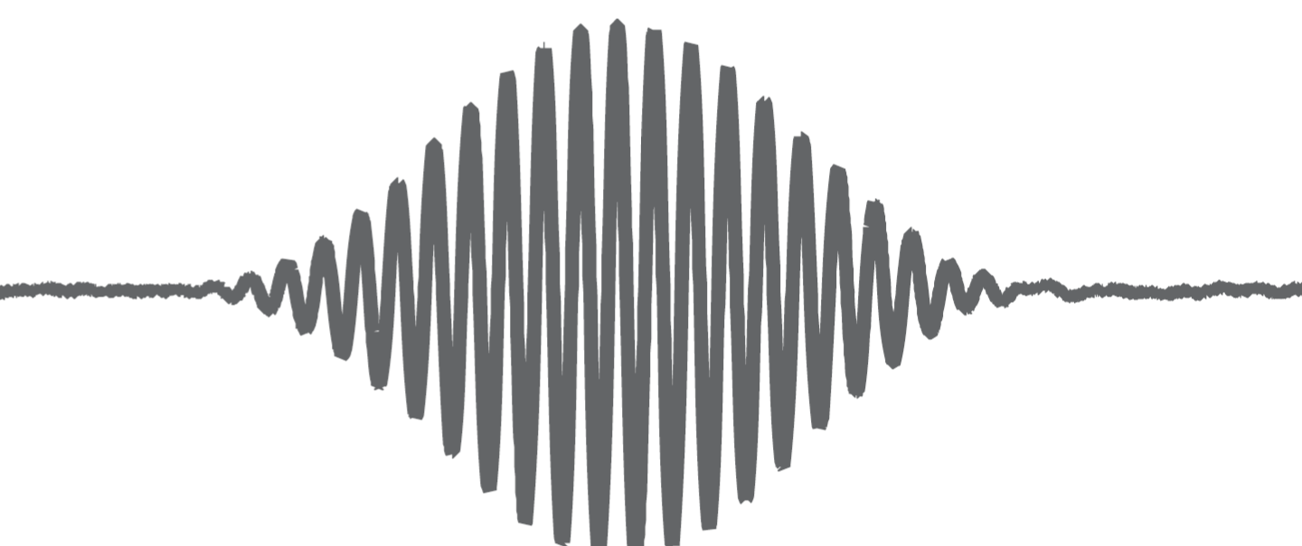

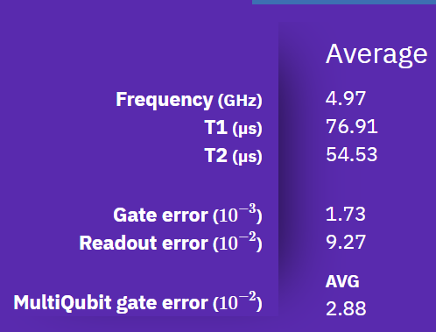
Characterization Methodology
Gate operations require analog pulses
Quantum computers require frequent calibration to get the best pulse
IBM calibrates machines multiple times a day and generate the report contains error rates for each qubit and link
We analyzed calibration 100+ reports over 52 days for IBMQ-20
Gate Pulse

Slide 10
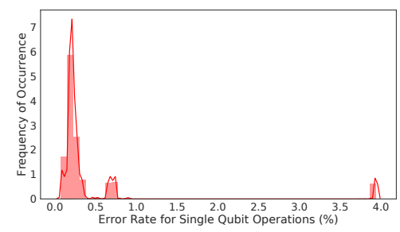
Single Qubit Gate Error Rates
Average error rate 0.26%
Single Qubit Gate errors have limited effect on the reliability

Slide 11
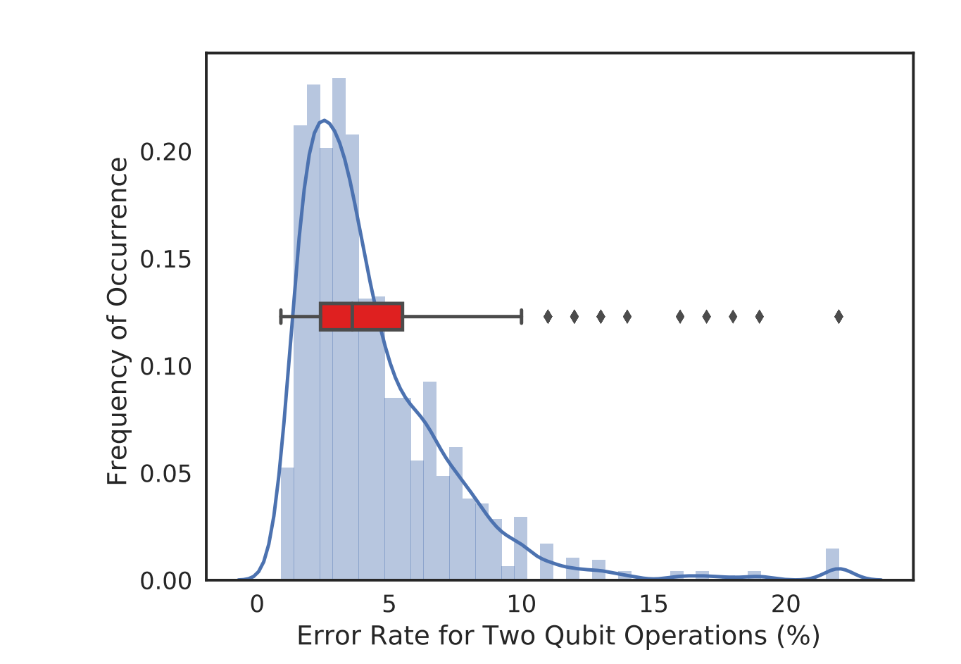
Two Qubit Gate Error Rate
Average error rate 4%
90th Percentile: Link Error 10%
Two qubit error rate is high and show significant variability

Slide 12
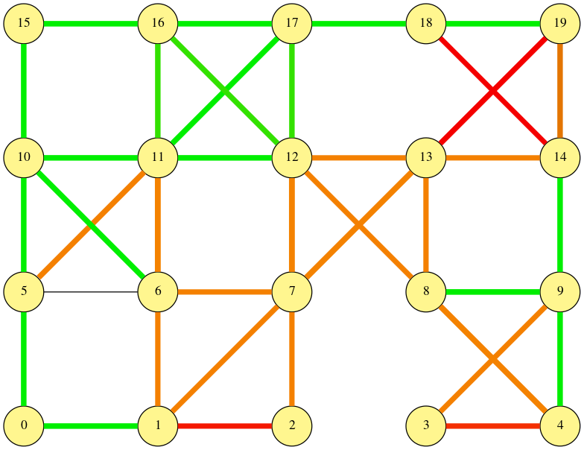
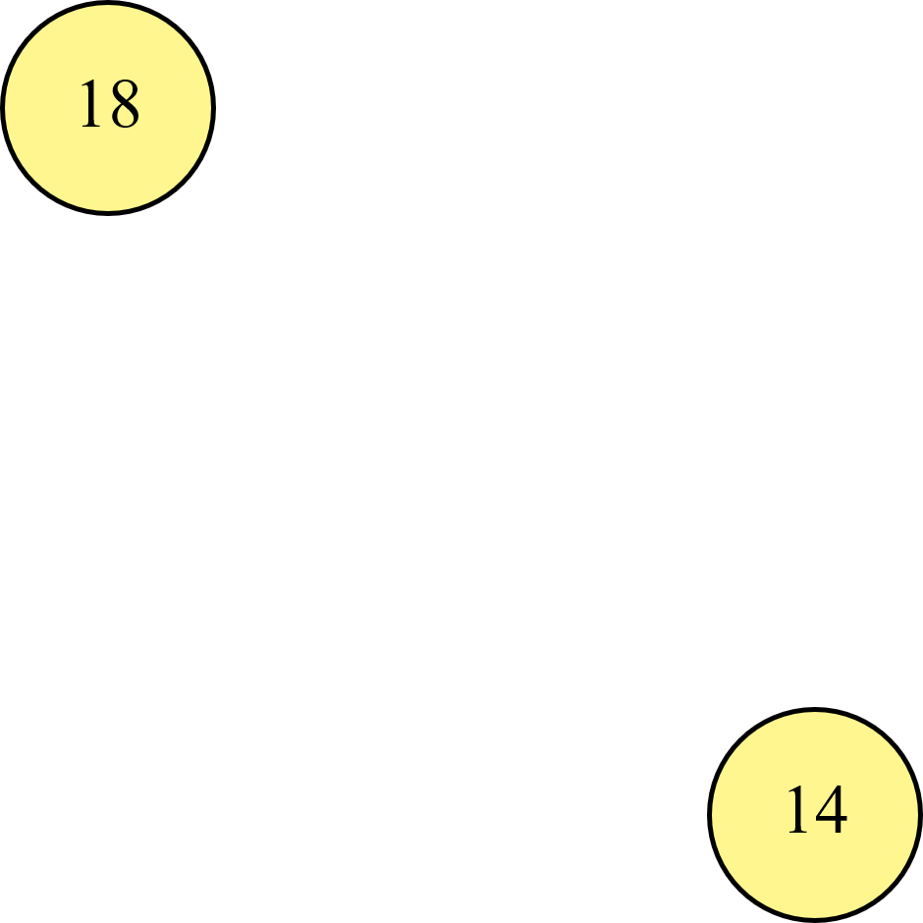

Spatial Variation in Two Qubit (Link) Error Rates
Worst link:
15% cnot error
Link Error Rate > 7%
3% < Link Error Rate < 7%
Link Error Rate < 3%
Average link error rate for 76 links in IBM-Q20 machine
Best Link:
2% cnot error
Some links are consistently more error prone than others

Slide 13
OUTLINE
Background
Error Characterization Data
Variability Aware Policies: VQA + VQM
Implementation
Evaluations

Slide 14
Variation-Aware Policy
Variation-aware Qubit Allocation (VQA)
Input Program
Variation-aware
Compiler
Connectivity Map
Variation-aware Qubit Movement (VQM)
Noise Characteristics
We propose variation-aware policy , to generate initial assignment and operation schedule that maximize the reliability, not just SWAP count

Slide 15
Qubit Movement
cnot A, B
cnot A, B
A
A
1
2
3
1
2
3
6
5
4
6
5
4
B
B
SWAPs = 2
SWAPs = 2
Multiple possible paths to entangle two qubits with identical SWAP cost

Slide 16

Variation-aware Qubit Movement (VQM)
A
Movement Path | Probability of Success
1-6-5 | 40%
1-2-3 | 50%
1-2-5 | 60%
0.9
0.9
1
2
3
0.95
0.95
0.95
6
5
4
0.8
0.95
B
cnot A, B
Chose a sequence of swaps that maximizes the reliability

Slide 17


Variation Aware Qubit Allocation (VQA)
cnot A,B
cnot B,C
cnot C,D
A
A
B
B
0.9
0.9
0.9
0.9
1
2
3
1
2
3
0.95
0.95
0.85
0.95
0.85
0.95
6
5
6
5
4
4
0.8
0.8
0.95
0.95
D
C
D
C
SWAPs = 0
PST = 0.61
SWAPs = 0
PST = 0.77
Choose qubits that maximizes the reliability

Slide 18
OUTLINE
Background
Error Characterization Data
Variability Aware Policies: VQA + VQM
Implementation
Evaluations
Notes:
VQA and VQM are general policy that can applied to any SWAP minimization proposal. In our paper, we extend Zulener et.al work

Slide 19
Implementation Example
Compute Pairwise Distance Table assuming Uniform SWAP cost
Partition the program into layers
Find SWAPs to minimize the A-Star
cnot
A
Logical Qubit DAG
Physical Qubit Connectivity
cnot A,B
cnot C,D
cnot A,C
cnot A,D
B
D
1
2
B
C
A
C
4
3
D
Input Program
L2P Map
Circuit Representation
of program
Map program on the physical qubits to maximize reliability

Slide 20
Variation-Aware Movement Design
L1
L2
L3
0.9
1
2
A
0.9
0.8
4
3
B
0.95
Form Layers
C
A
B
D
C
A
B
A
B
A
B
D
1
2
1
2
1
2
L2P
Map for
Layer
M1
M2
M3
4
3
4
3
4
3
C
D
C
D
D
C
Partition circuit in Layers (L_{i}) & Find L2P Map (M_{i})

Slide 21
Variation-Aware Movement Design
L1
S12
L2
S23
L3
0.9
1
2
A
?
?
0.9
0.8
4
3
B
0.95
Form Layers
C
A
B
D
C
A
B
A
B
A
B
D
1
2
S12
1
2
1
2
L2P
Map for
Layer
S23
M1
M2
M3
Input Circuit
4
3
4
3
4
3
C
D
C
D
D
C
Search for set of optimal SWAPs (S_{i, i+1} ) to transform M _{i} to M _{i+1}
Notes:
Once we have mappings for all layers, find optimal set of SWAP operations to transform M1 to M2 and M2 to M3, because when we SWAP we change the logical to physical mapping
click
In this example, we find S12 which requires no SWAPs cause M1 and M2 are the same
Then we

Slide 22
Variation-Aware Movement Design
Find set of least number of SWAPs (S_{i,i+1} ) to transform M_{i} into M_{i+1} using A-star search
Final Schedule with SWAP (VQM)
A
L1
S12
L2
S23
L3
A
B
?
?
C
B
D
PST: 0.65
C
SWAP = 1
A
A
B
D
0.9
1
2
B
A
B
A
B
A
B
0.9
0.8
C
2
1
1
2
1
2
4
3
D
PST: 0.55
0.95
M1
M2
M3
C
D
4
3
4
3
4
3
Final Schedule with SWAP (baseline)
Initial L2P Mapping
C
D
C
D
D
C
Variability-aware movement actively avoid unreliable links

Slide 23
VQA Design: Balancing Reliability and Connectivity
Strongest subgraph with degree > 3
Find strongest subgraph (SG_{k}) by pruning the weak qubits
Map program qubits with high activity on strong qubits (nodes)

Slide 24
OUTLINE
Background
Error Characterization Data
Variability Aware Policies: VQA + VQM
Implementation
Evaluations

Slide 25
Evaluations for IBM-Q20 Simulator
83%
Variation unaware baseline
Relative PST
VQA+VQM improves PST up to 1.83x over variation-unaware baseline

Slide 26
Evaluations on Real System: IBM-Q5
90%
Variation unaware baseline
Relative PST
On IBM-Q5, VQA+VQM improves the reliability up to 1.9x

Slide 27
Conclusion
Reliability is a key challenge for near-term quantum computers
Not all Qubits are created equal: significant variation in error rates
Proposed variation-aware policies improves reliability by actively
avoiding error-prone qubits/links
Significant improvement in reliability (up to 90%)
Notes:
To conclude

Slide 28
Thank you
Questions?
Notes:
Thanks and I am happy to take questions

Slide 29
Backup Slides

Slide 30
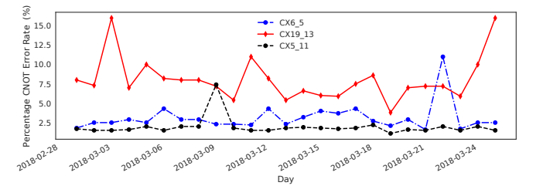
Temporal Variation in Two Qubit Error Rates
Weak
Link
Strong Links
Operational error-rates have low temporal variation in a small time window, the error-rates evaluated during calibration can be used by the compiler

Slide 31
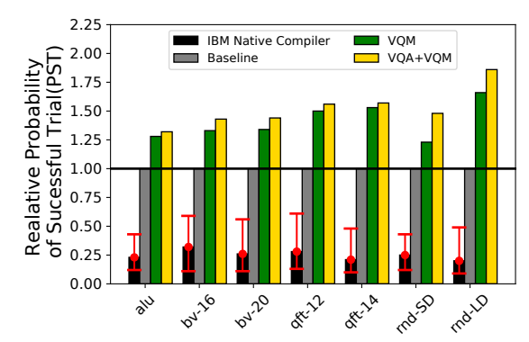
Comparing VQA+ VQM with IBM’s Native Compiler
On simulator with IBM-Q20 data
Our evaluations show up to 7x improvement in PST over IBM’s native compiler

Slide 32
Spatial Variability in SWAP Error Rates on IBM-Q20
Worst link:
15% cnot error
Link Error Rate > 7%
3% < Link Error Rate < 7%
Worst SWAP 40% Chance of Failure
Link Error Rate < 3%
Best SWAP
6% probability of Failure
Average link error rate for 76 links in IBM-Q20 machine
Best Link:
2% cnot error
SWAP requires 3 CNOT ops, SWAP on weakest link degrade PST by 50%

